Slide 1
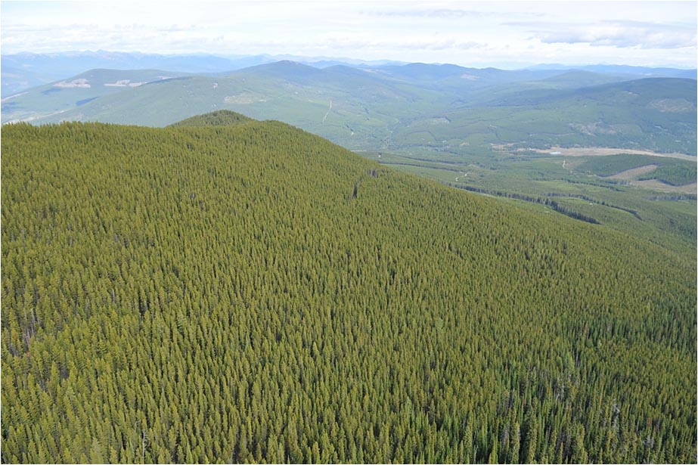
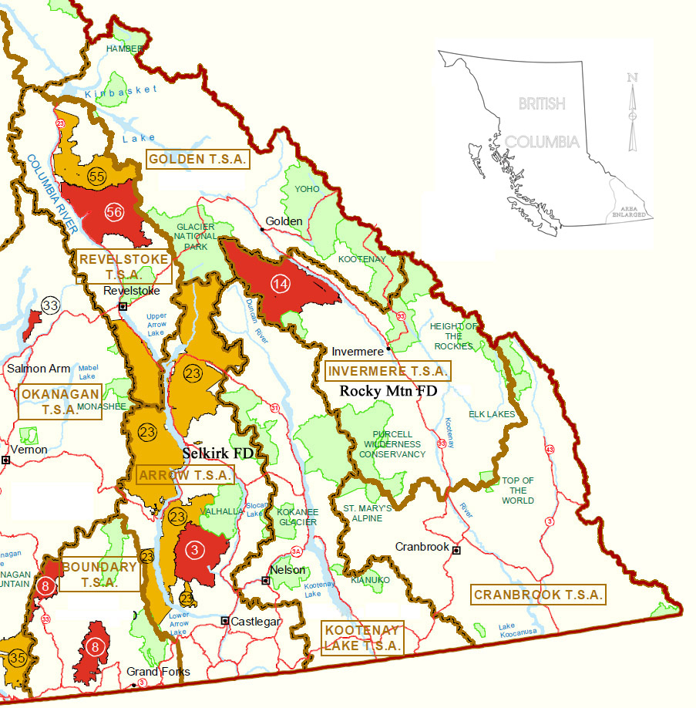
Kootenay-Boundary Region
2 Districts
7 Timber supply Areas
Diverse forests with 13 commercial conifer species.

Slide 2
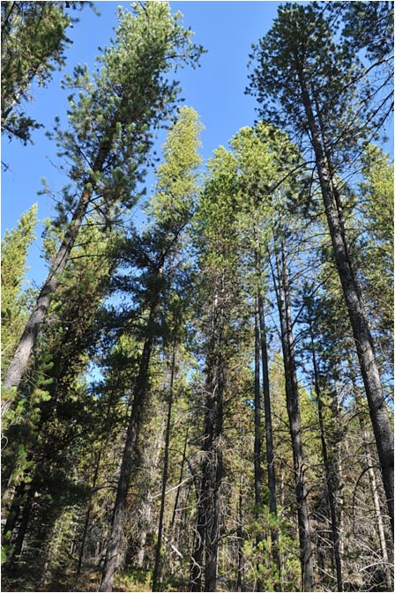
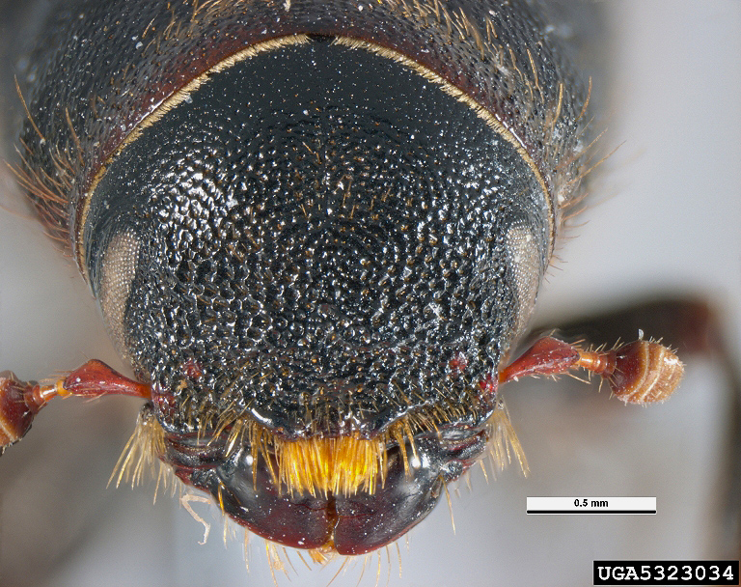
Bark beetle management review
VS.
Mountain pine beetle,
Douglas-fir beetle,
spruce beetle

Slide 3
Agenda
Common features of bark beetle life cycles
Common features of bark beetle management
Selecting and implementing strategies
Population dynamics and management options for IBM, IBD, IBS
Post-fire management
Lightly covered: specific life cycles
Not covered: surveys, specific susceptibility ratings
Notes:
Lightly covered: specific life cycles, incidentally as needed
Not covered: surveys, specific susceptibility ratings

Slide 4
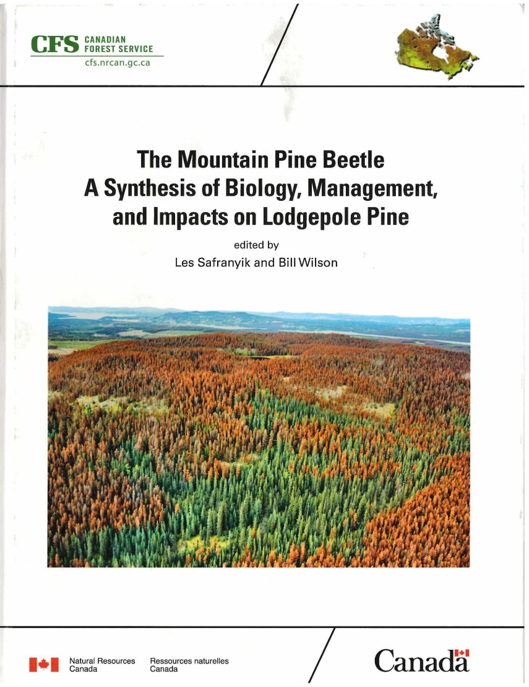
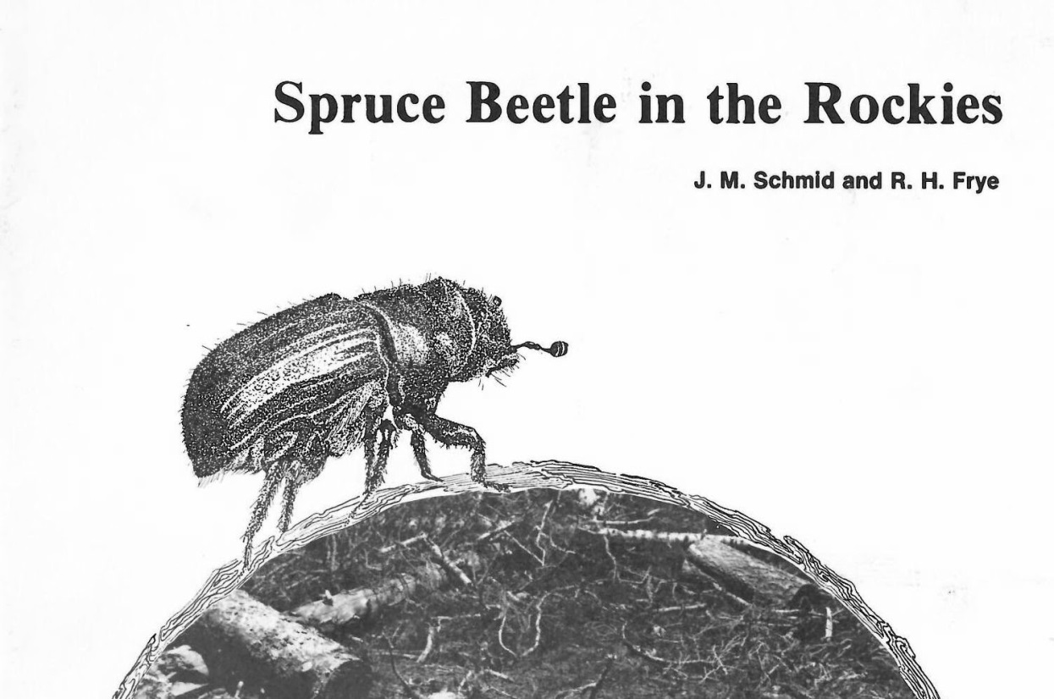
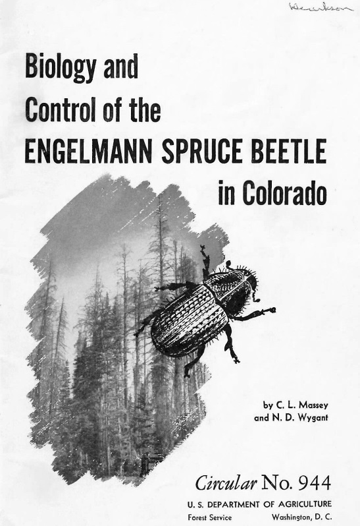
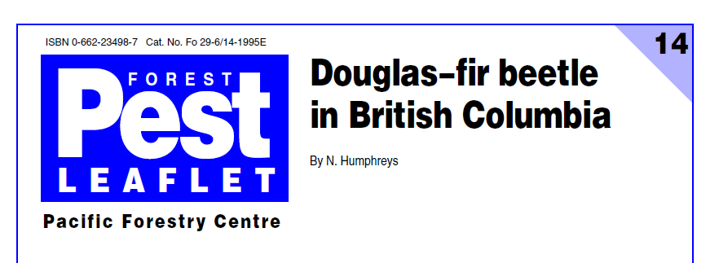
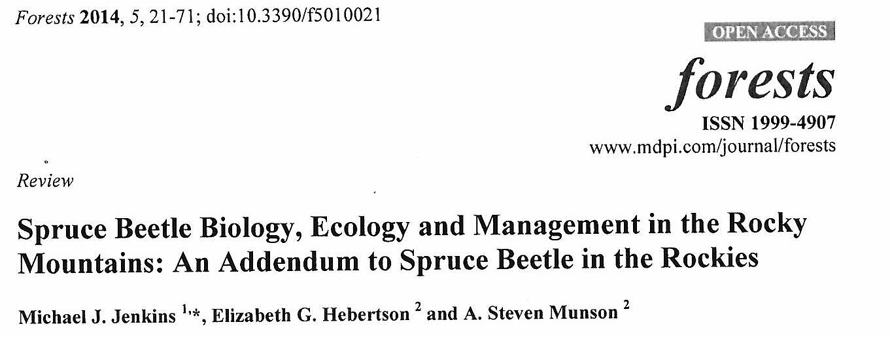

Slide 5
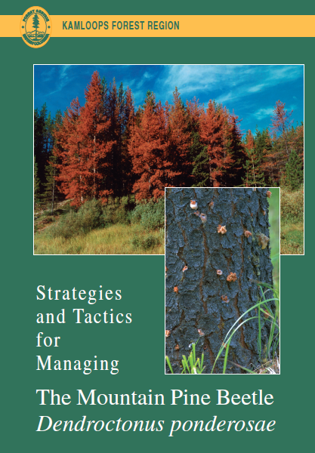
More stuff:
Bark Beetle Management Guidebook October 1995
https://www.for.gov.bc.ca/tasb/legsregs/fpc/fpcguide/beetle/betletoc.htm
ftp:\RSI\external\outgoing\Art_Stock\BB info

Slide 6
Common features of bark beetle life cycles:
IBM, IBD, IBS, IBB, IBW, IBF
Host Selection
Mass Attack
Fungi
Phloem Feeders
Life Stages

Slide 7
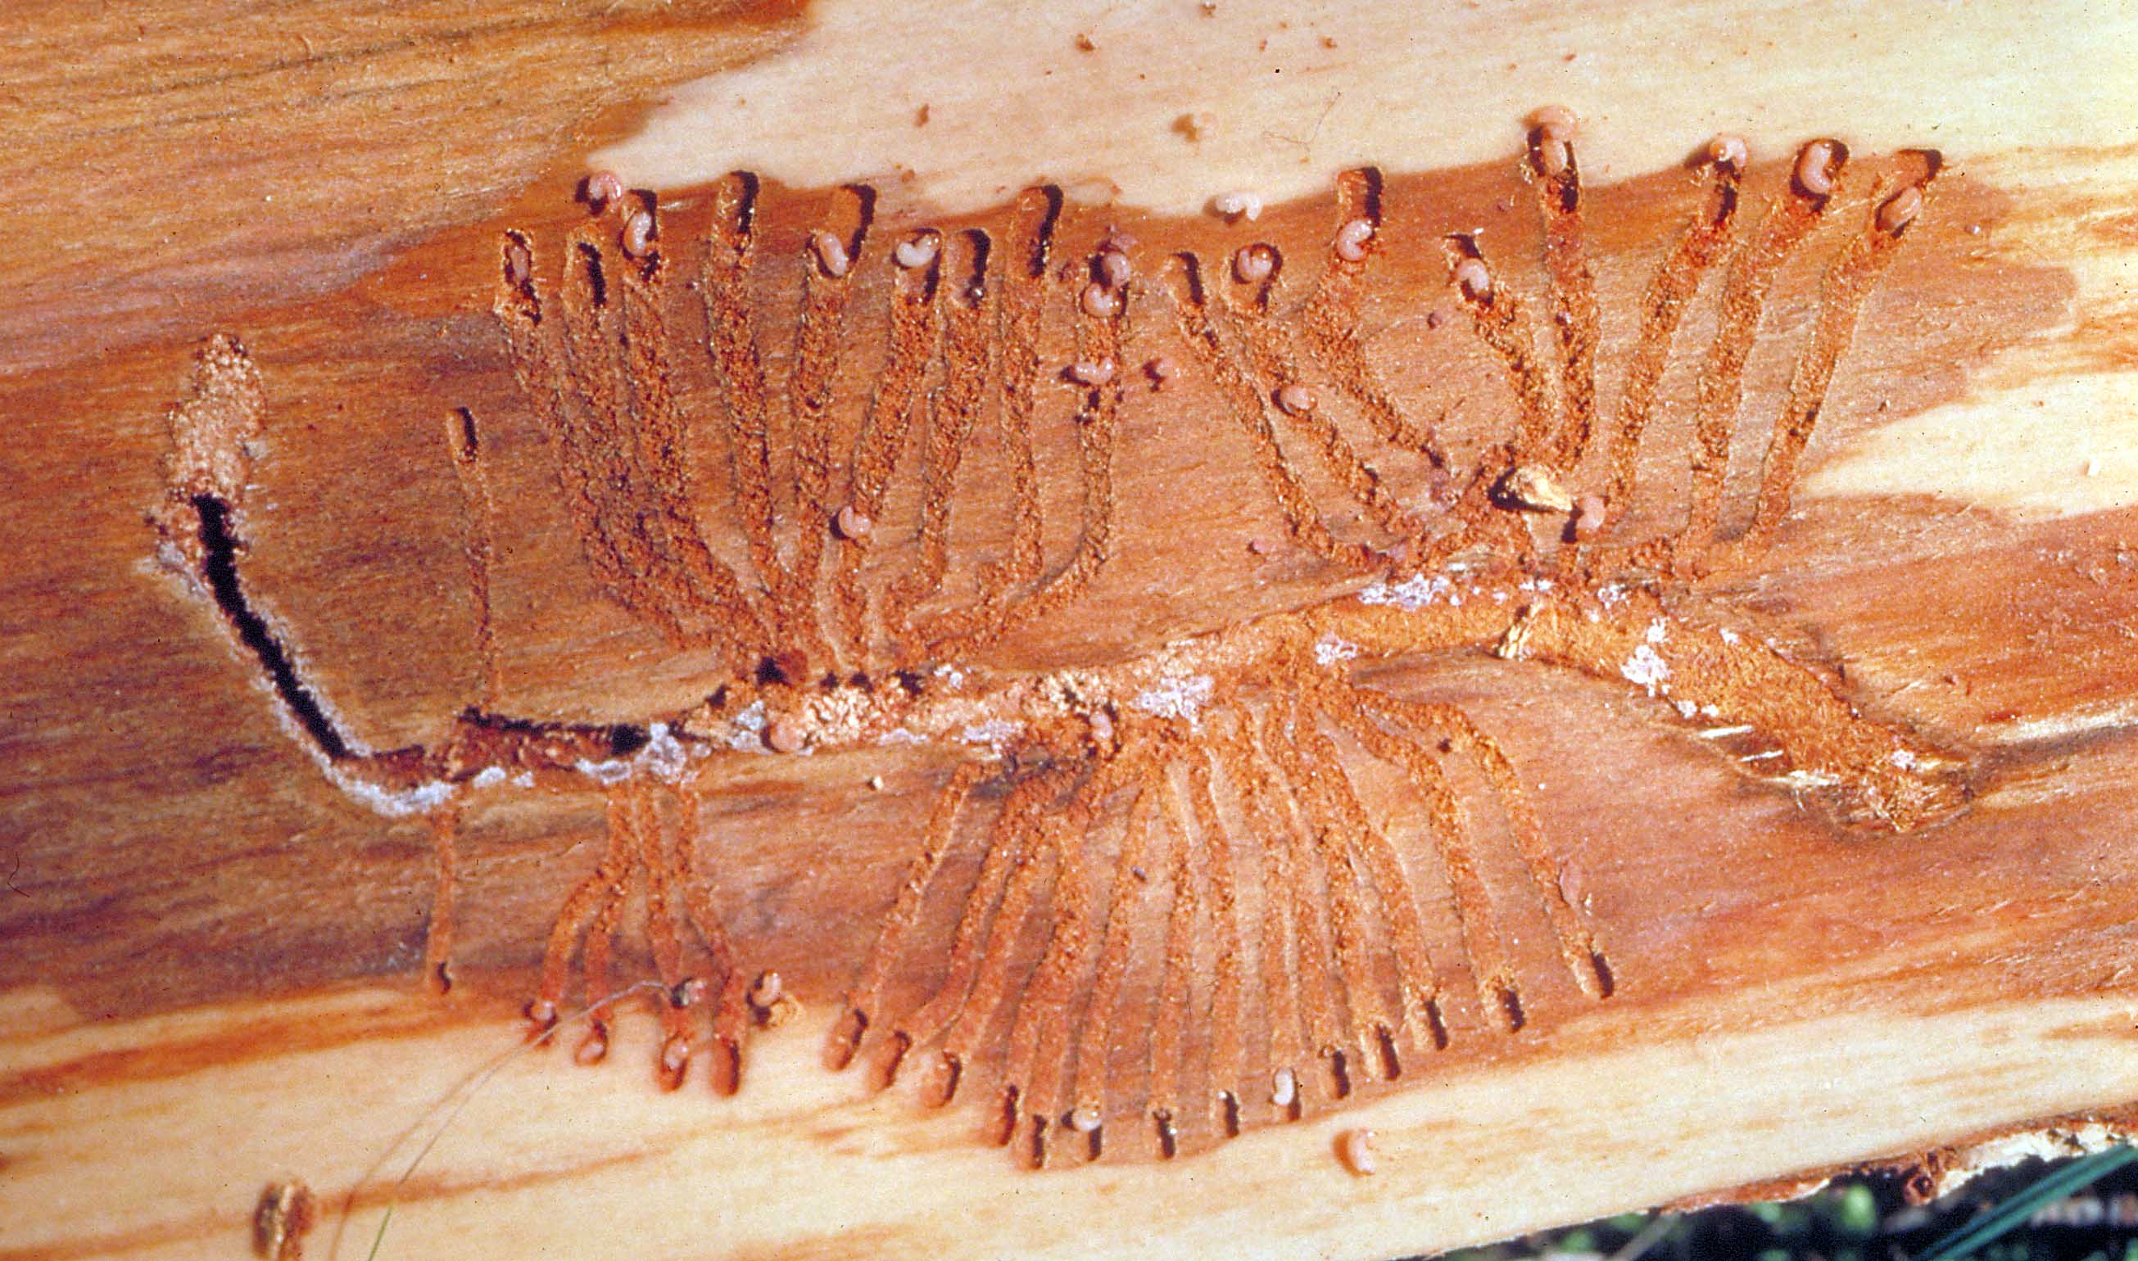
Common features of bark beetle life cycles:
PHLOEM FEEDERS
Larvae and adults feed on living tissue under the bark.

Slide 8
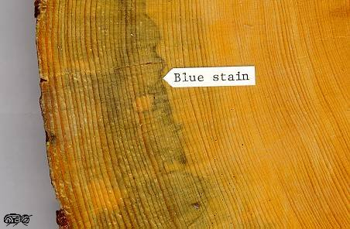
Common features of bark beetle life cycles: FUNGAL COMPLEX
A symbiotic relationship
The “blue stains” kill the tree (in combination with larval feeding)
Prevents resinosis and translocation
Maintains micro-climate (moisture) under the bark
Volatile (pheromone) production
Nutritional role

Slide 9
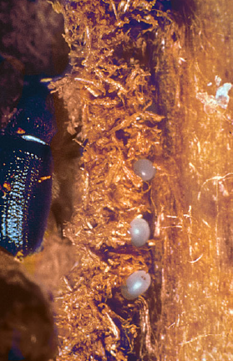
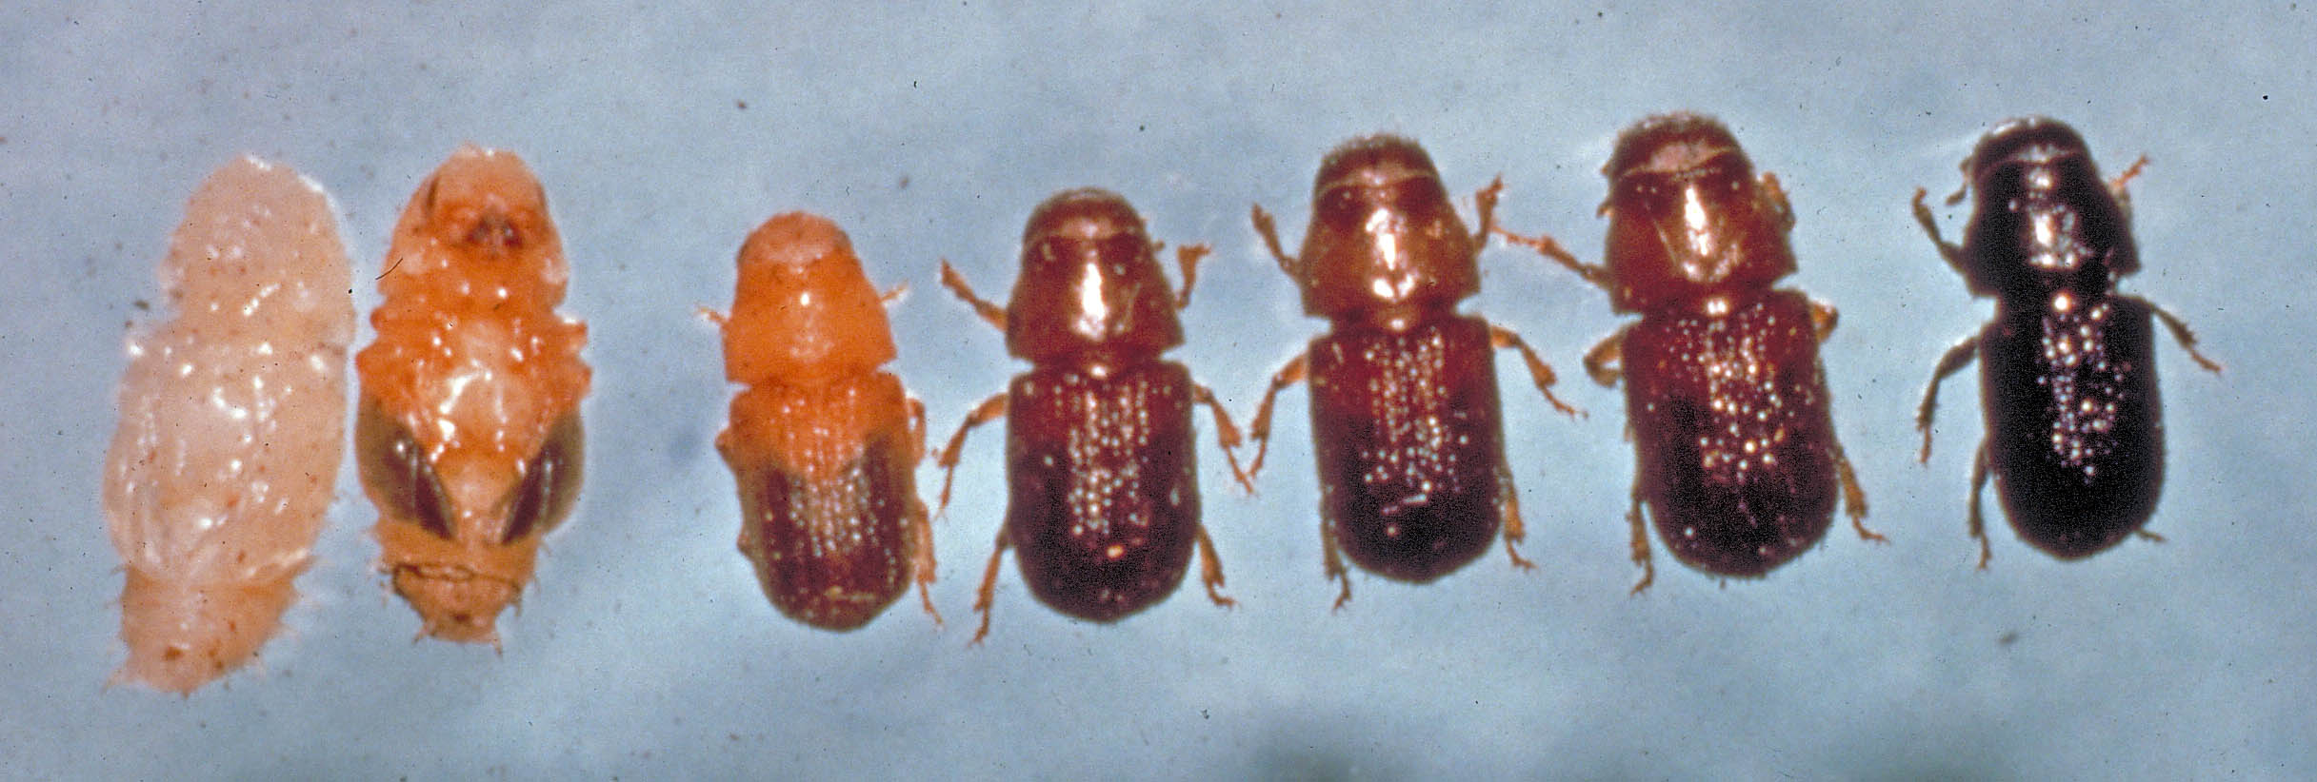
Common features of bark beetle life cycles:
LIFE STAGES
Egg – summer, not hardy
Larvae – usually 3-4 instars, winter stage
Pupa – full metamorphosis, spring, fragile
Adult – summer dispersal flight,
sometimes an overwintering stage
Development thresholds are heat dependent

Slide 10
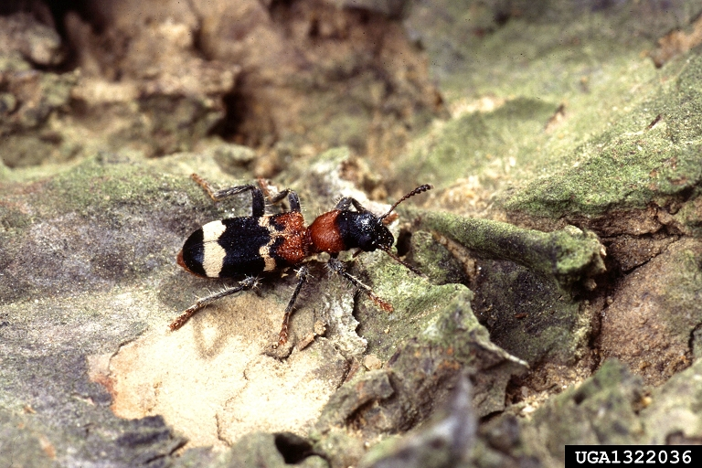
Common features of bark beetle life cycles:
MORTALITY FACTORS
COMPETITION and cannibalism
CLIMATE cold
DRYING
PITCH
DISEASES
PARASITES AND PREDATORS
  Flies, beetles, wasps, and woodpeckers

Slide 11
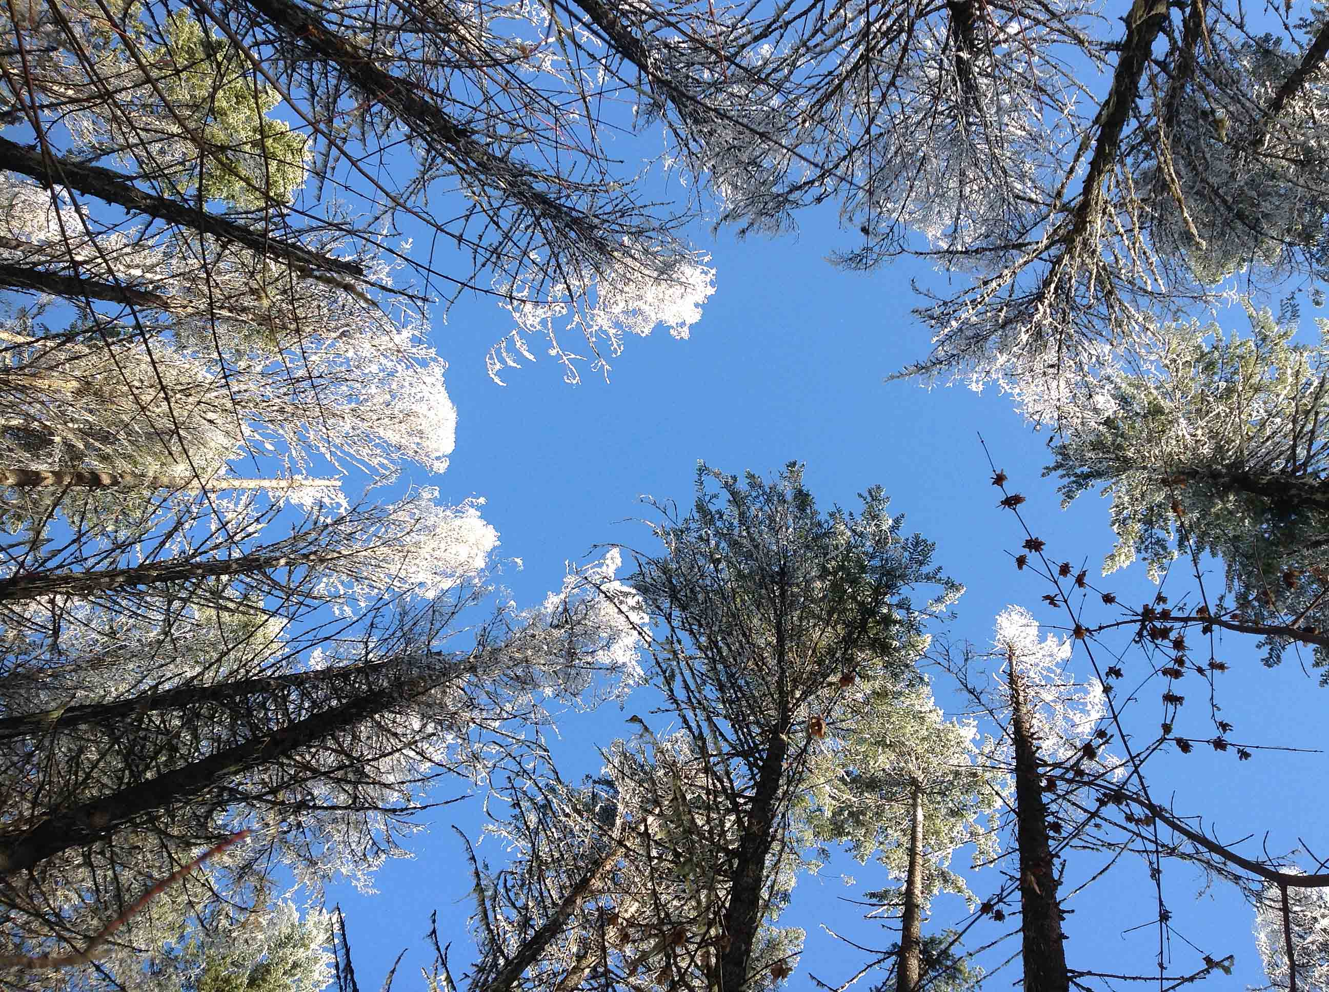
?s

Slide 12
Bark beetle management:
Basic Elements of Direct Control
Continuous surveillance
Consistent strategic, planning, and operational approach at TSA level
Flexibility in all plans at all levels
Early detection and assessment
Aggressive rapid response in real time
All tactics considered
Continuation of treatments as long as necessary
Emphasise sanitation harvesting
Follow-up surveillance

Slide 13
Bark beetle management:
Influencing factors?
Weather and global warming
Amount of susceptible species at risk
Mixed forests
Topographic breaks
Organisation
Strategies
Policies
Notes:
The weather in the Kootenays Is warm. Is not cold. Can be really wet in the summer. Is not usually limiting to IBM. Never count on the weather.
The Kootenays have mixed forest types. Less pure pine than the Central Interior. Which can be GOOD, somewhat, if you have IBM, but IBM not stopped.
Allows more stable mid-term wood supply BAD if you have IBD, IBS, IBW, and IBF…….for which there might be no funding
Mountainous regions impose some restriction on beetle dispersal. It can be tough for road building and harvesting.
It makes fixed-wing overview flying more interesting….

Slide 14
Min Temp Days (average 1971 – 2000)
Min T °C | Castlegar days | Cranbrook days
> 0 | 238.6 | 189
0 to -2 | 46.4 | 35.1
-3 to -10 | 65.6 | 92.2
-11 to -20 | 13.94 | 35.9
-21 to -30 | 0.66 | 11.4
< - 30 | 0 | 1.6

Slide 15
Bark beetle management: Susceptibility rating
How much damage is expected if an infestation occurs.
  Site quality
  Age
  DBH
  Stand density (growth rate)
  Percentage susceptible host basal area
  Stand location i.e. elevation, latitude, longitude, aspect
Planning tool

Slide 16
Bark beetle management:
Strategy selection factors
Proportion of susceptible types infested
Available harvest and treatment capacity to remove target %
Access
Infestation distribution (spot:patch ratio)
Infestation size
Green to red ratio
Set at Landscape Unit (BMU) level

Slide 17
Bark beetle management:
Strategy - Suppression
Aggressive direct control to keep low level of infestation.
Harvesting and milling capacities equal or exceed the amount of infestation.
Objectives are to harvest or treat >= 70% of all known infested material in any given year (or 2 years…?)
Aggressive focussed harvesting is essential
Notes:
This was mostly developed for MPB, but general principles are applicable to all beetles.
The province currently uses four (4) possible BMU strategies. These strategies are selected based on the level of outbreak in an area and the estimated effectiveness of selected treatments in achieving stated objectives. The strategy chosen for a BMU should remain in place for as long as the objectives are being met or until additional resources become available to allow a more aggressive strategy to be implemented. However, situations change from year to year, and therefore strategies must be reassessed on an annual basis. Strategy selection criteria assume that resource and land use objectives have been met and are given in terms of beetle infestation status and the feasibility of reducing damage. The most technically correct strategy may not always be selected for a given BMU because other criteria can override technical considerations. For instance, watershed or aesthetic considerations can limit the application of aggressive directed harvesting. Socio-economic forces will also influence the selection of strategies and tactics.

Slide 18
Bark beetle management:
Strategy - Holding
Maintain an existing outbreak at a relatively static level.
Areas with larger chronic beetle infestations
Objective: harvest or treat approximately 50% of known currently infested material in any given year.
Notes:
Holding: The intent of this strategy is to maintain an existing outbreak at a relatively static level. It is a delaying strategy until adequate resources are available or access created that allow for a more aggressive approach, or to reduce overall loss while waiting for a killing climatic event. This is appropriate in areas with chronic beetle infestations that are too large to deal with using single tree treatments or where access is poorly developed for directed harvesting

Slide 19
Bark beetle management:
Strategy – Salvage
Where management would not reduce beetle populations or damage.
Extensive outbreaks over large proportion of susceptible stands.
Objective is to recover some value
Notes:
Salvage: Applied to areas where management efforts would be ineffective in substantially reducing the beetle populations and subsequent levels of damage. Such areas have extensive outbreaks covering a large proportion of susceptible stands. The objective in this case is to salvage affected stands and minimize value loss. Emphasis is more to retrieve values at risk and maximize Crown revenues by directing harvest towards killed stands prior to significant degrade. This strategy may also apply to areas containing small volumes of pine or areas where the pine is marginally economic – that is, where control is not worth the effort that would be expended and the objective is to salvage whatever values are there.

Slide 20
Bark beetle management:
Strategy – Monitor
Where management would not reduce beetle populations or damage
No short term (less than 5 years) possibility of salvaging dead timber
Notes:
This was previously called “Abandon”…

Slide 21
Bark beetle management:
Values at risk and suppression benefits
Industry competitiveness: major supply of undamaged wood. Even flow of timber.
Community stability
Mid-term timber supply and revenue generation: Green timber will increase in value.
Other resource values: Less impacts on wildlife, water, range, recreation, endangered species.
Public safety: fire interface issues/costs reduced.
Notes:
Industry competitiveness: The KBC will benefit by having the major supply of unstained green pine (if beetle management is maintained). This is important in KBC because there are several value-added mills that lose significantly if unstained wood is not readily available.
Community stability: Treating IBM results in an even flow of timber over time. This provides secure and stable employment as well as other economic factors that help maintain community stability;
Mid-term timber supply and revenue generation: Green timber across BC will increase in value as the shelf life of beetle impacted forests runs out in the central interior and US housing starts return to the trend line of 1.5 million starts. Extending KBC timber flows for 8 – 20 years extends higher-value revenue generation, and reduces volume added to the current oversupply of dead pine.
Other resource values (wildlife, water, range, recreation, etc.) are less impacted because orderly planned harvest allows accommodation of non-timber values with less conflict.
Public safety is enhanced because fire interface issues/costs are reduced if beetle management avoids/prevents fuel accumulations.

Slide 22
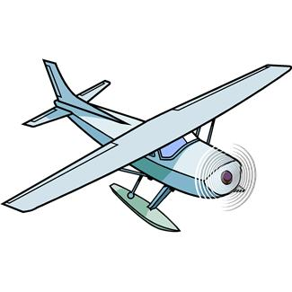
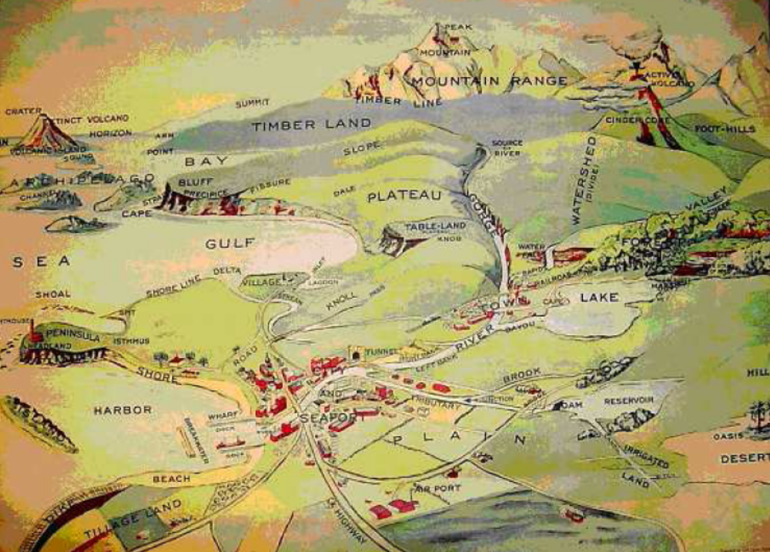
Forest Health Surveys
Survey objectives: verify population levels, trends, and location.
Aerial overview surveys
Notes:
Landscape level – tracking major population levels and trends. Fixed wing, late July-mid-August .

Slide 23

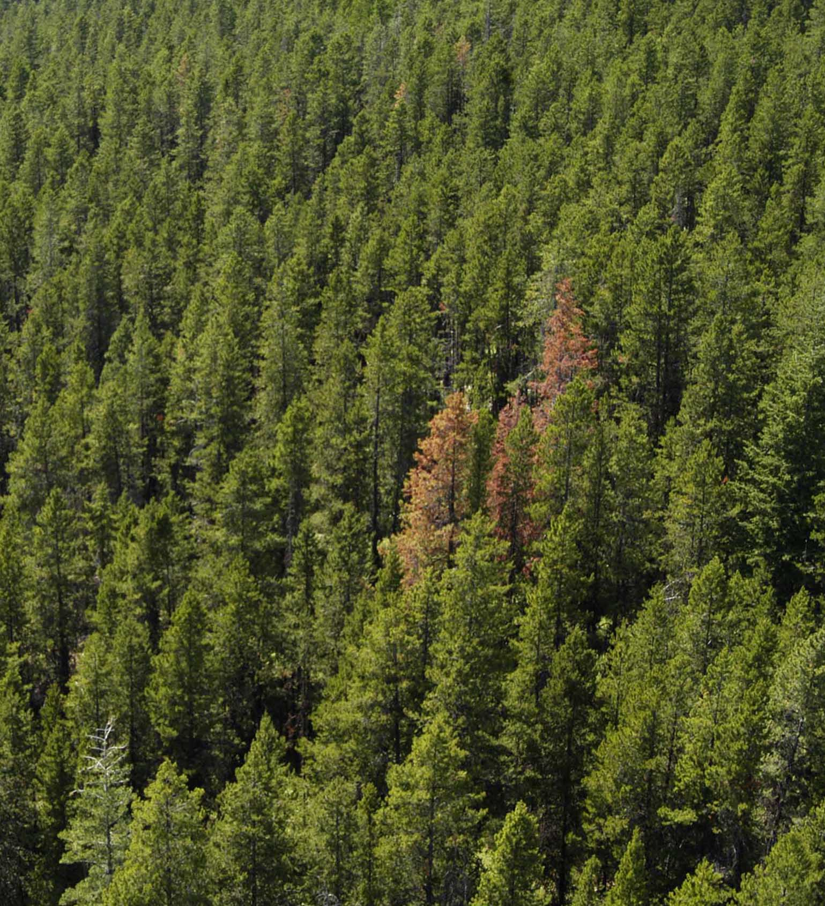
Bark beetle management:
Surveys
Aerial overview surveys
Operations detailed surveys
  Air
Notes:
Accurate stand level mapping

Slide 24

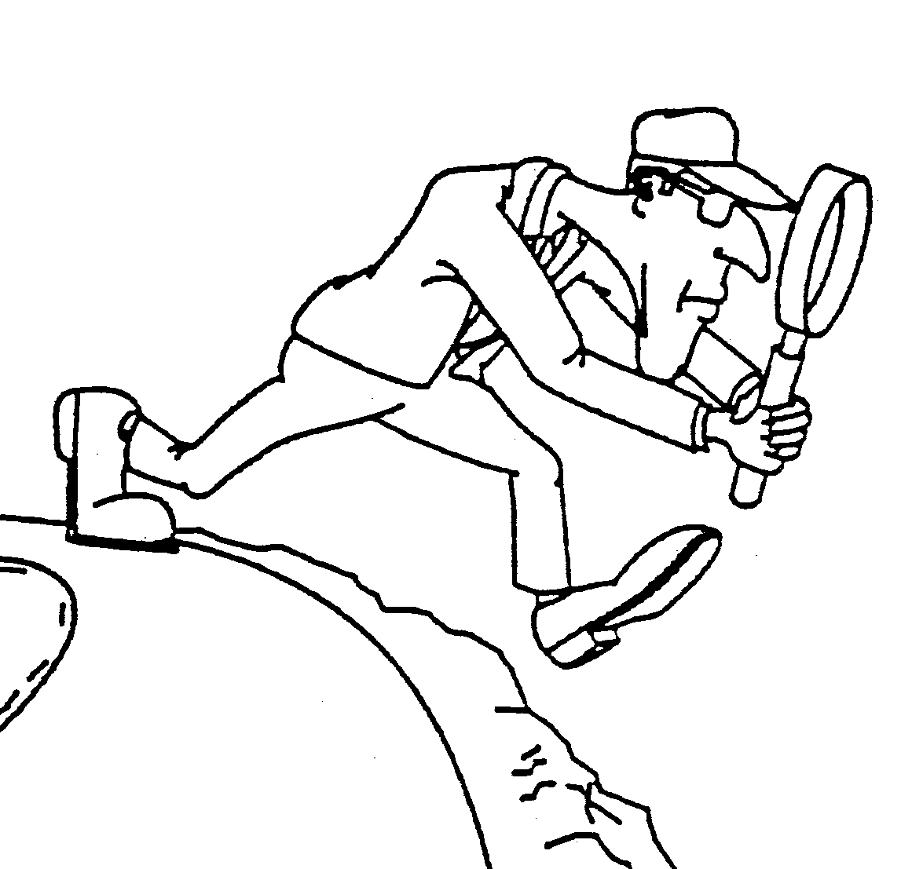
Bark beetle management:
Surveys
Aerial overview surveys
Operations detailed surveys
  Air
  Ground – assessment of intensity and locations
Notes:
Accurate stand level mapping

Slide 25
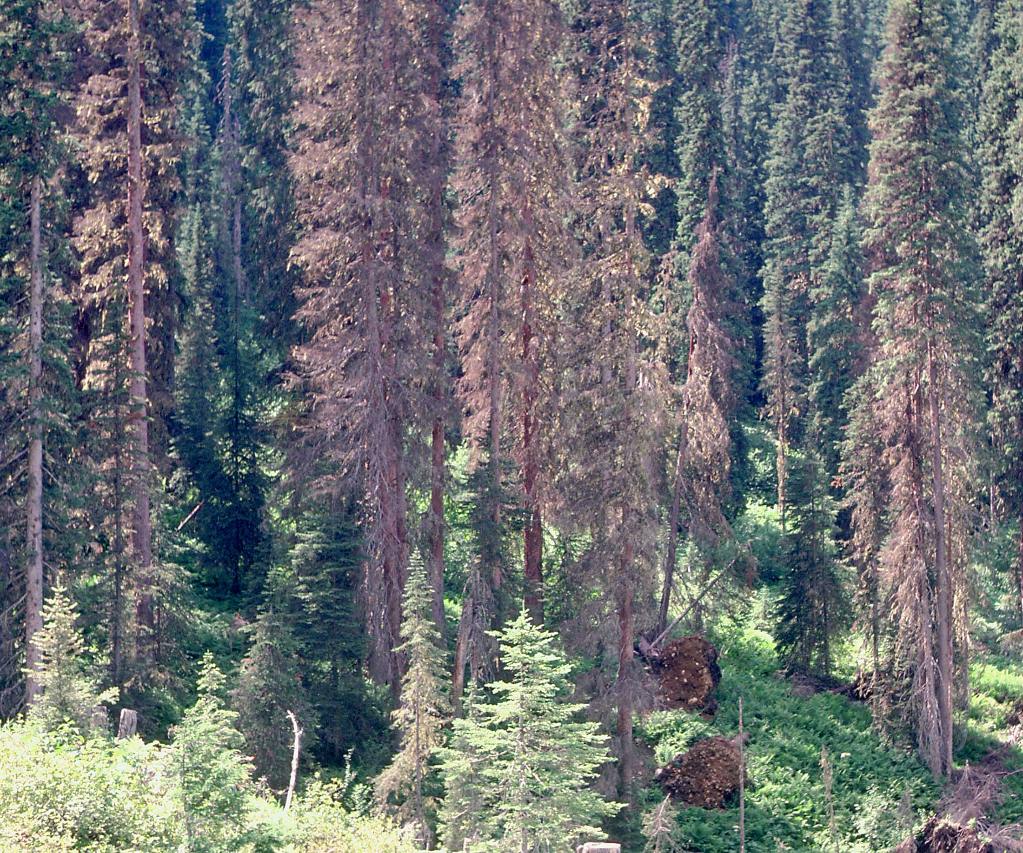
Bark beetle management:
Surveys – Diagnostic features
Crown
Pitch, pitch tubes
Frass
Egg galleries
Life stages and timing
Stain development
Emergence holes
Wood pecker feeding
and bark flakes
Bark miners

Slide 26
Bark beetle management:
FROM SURVEYS:
Stand management decision information
Susceptibility of infested stand - % susceptible species
Infestation levels and history
Beetle pressure
Operability – access, slope
Merchantability (dbh, green-red-gray)
Harvest highest ranked stands first
Notes:
Assuming there is a harvest priority ranking system in place…

Slide 27
Bark beetle management:
Sanitation Harvesting
Maximize extraction of currently infested or infected stands to reduce the damage caused by forest pests and to prevent their spread.

Slide 28
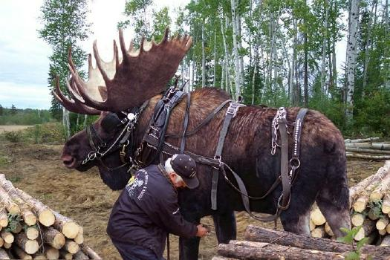
Bark beetle management: Sanitation harvesting
  Tree baits?
  Low stumps.
  Avoid damage to residual trees.
  Remove infested debris, no long butting.
  Hot mill if appropriate.

Slide 29
Bark beetle management:
Salvage Harvesting
Recover timber damaged or degraded by fire, an old insect attack, wind, or disease before wood becomes unmerchantable.
Control of forest health factors such as bark beetles is incidental and not the primary objective of salvage logging.

Slide 30
Bark beetle management: Pheromones
Mass trap with funnel traps – DFB
Concentrate and contain with tree baits in planned cut blocks – IBM, IBD, IBS
Anti-aggregation – IBD, IBM, (IBS)
Push-pull – IBD, IBM
Monitor flight periods for restricted hauling

Slide 31
Bark beetle management:
The fumble factors
Radical change in policy CAN induce radical change on the ground...
Strategic planning and treatment application must be organised and consistent across the landscape
Blowdown and debris assessment/management must be consistent across the landscape
Administrative processes delay harvest across at least one beetle flight
Loss of corporate memory is now a significant issue
Notes:
Policy: Softwood lumber agreement, Tenure and CP management, FRPA and professional reliance - effects?

Slide 32
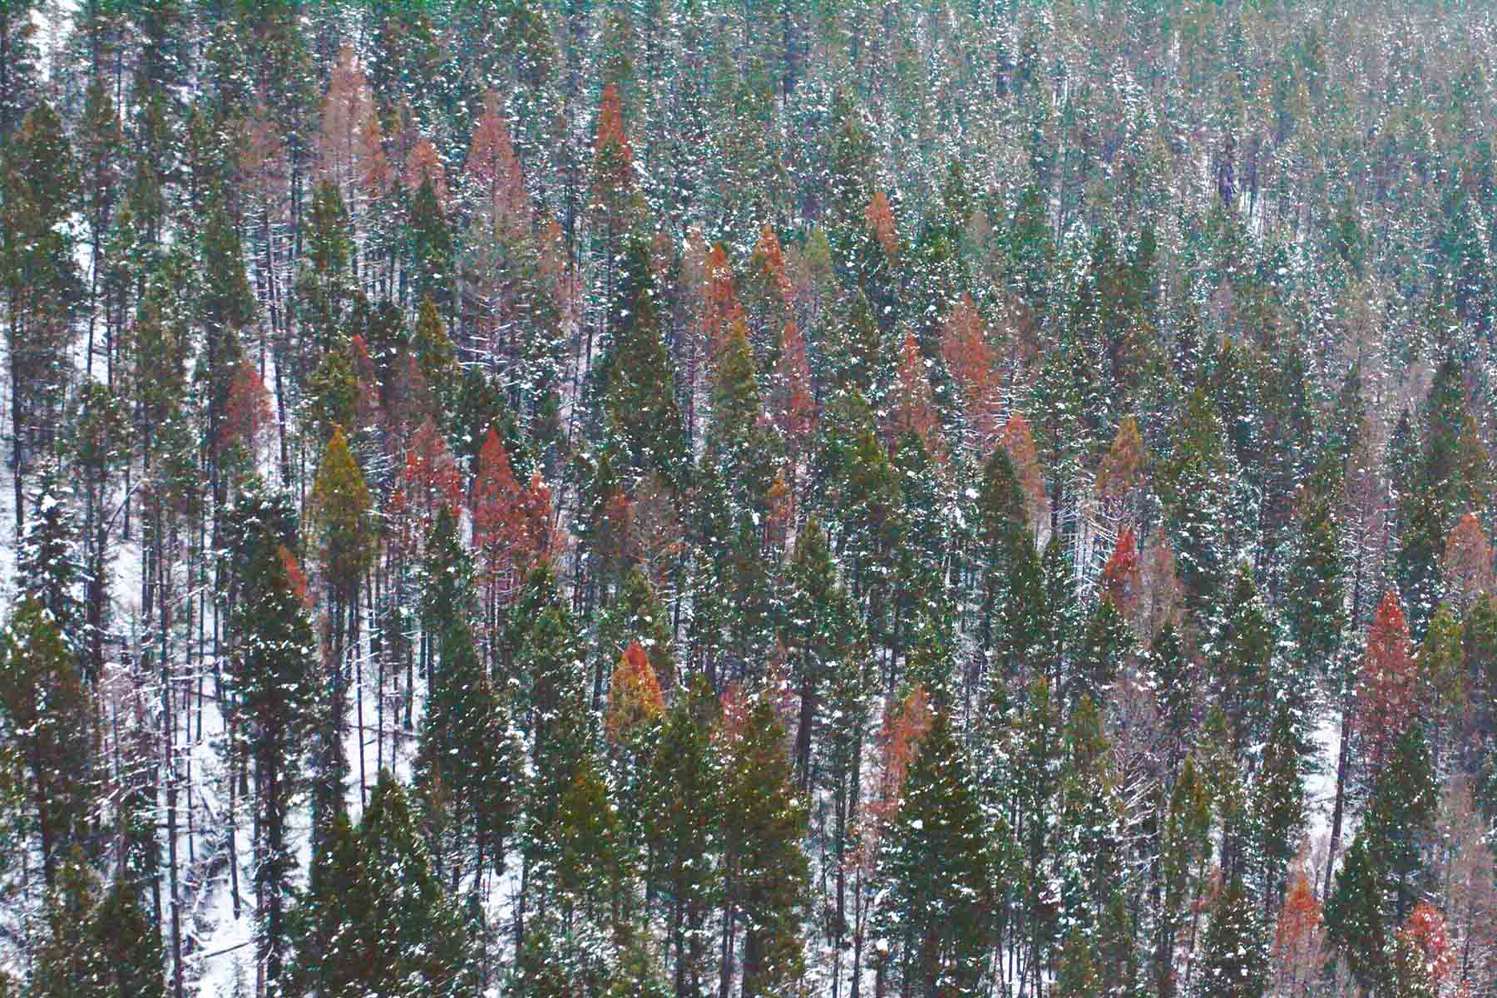
?s

Slide 33
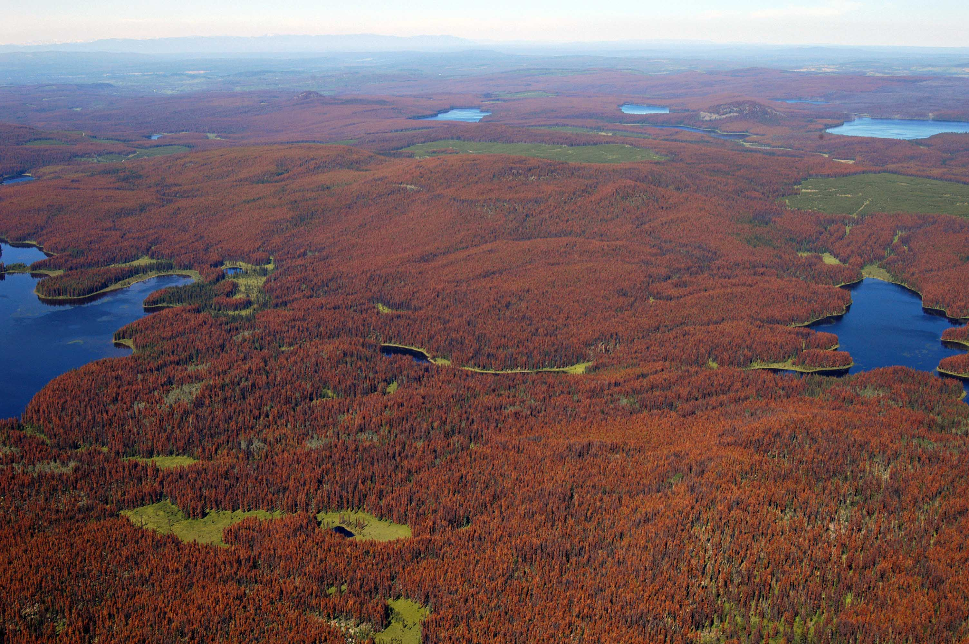
Mountain pine beetle
Mountain pine beetle
Dendroctonus ponderosae (Hopk.)

Slide 34
Notes:
Shore-Safranyik hazard rating above 33 points, based on BC inventory data, 2013

Slide 35
Mountain pine beetle ha_TSA 2010-2015

Slide 36
Recent outbreaks
(or, outbreaks with usable data)
’62? – ’86 in East Kootenays (Flathead)
’85 – ’92 in West Kootenays (Boundary)
Chronic populations - incipient or greater mountain pine beetle populations since at least 1960 – 55 years!
ART STOCK CONsulting, LTD.

Slide 37
Mountain pine beetle:
Population dynamics - Endemic populations
Infests weakened and decadent trees
Frequently with secondary bark beetle species. Very difficult to find
Current attack often not near brood trees
No obvious relationship between the probability of attack and tree dbh
Yearly tree mortality is normally less than volume growth.

Slide 38
Mountain pine beetle:
Population dynamics - Incipient epidemic
Infested trees tend to larger diameter classes;
Infested spots of infested trees are scattered and confined to some stands;
Spots vary considerably in size and number from year to year but tend to grow over time;
Trends often escape detection/assessment
Explosive nature of MPB badly underestimated
Notes:
Often, spots first appear in: draws and gullies, edge zones of places with wide fluctuations in the water table; Pl among patches of aspen (root disease?); dry, south and west-facing slopes.

Slide 39
Mountain pine beetle:
Population dynamics - Epidemic
Incipient populations grow and coalesce at landscape level
Sustained favourable weather combined with an abundance of susceptible hosts.
Usual annual rate of increase 2 to 4 x over the epidemic area.
Large annual increases in both infested areas and numbers of infested trees
Lasts 10-15 years

Slide 40
Notes:
Location factors are derived from SSI (Shore and Safranyik 1992).

Slide 41
Mountain pine beetle:
Management
The natural situation results in about 40% of trees (and 60% of volume) lost over 10 - 15 years
The train cannot be stopped but it can be slowed
The objective is to slow the outbreak down as much as possible.
Notes:
The natural situation results in about 60% of trees killed within 10 or 11 years;
Annual treatment of 40% of all currently infested trees causes the outbreak to last nearly 20 years, with fewer trees killed overall; and,
Treating 80% of all infested trees results in a very significantly reduced outbreak period and number of trees killed.

Slide 42
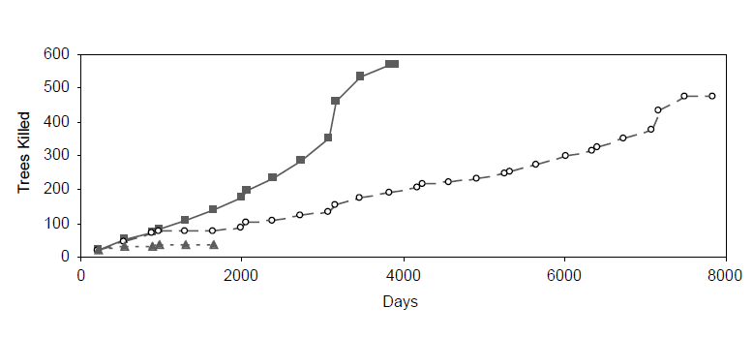

Mountain pine beetle:
Harvesting
Effect of harvesting infested trees each year
Notes:
Initial number of trees = 950
600/950 = 63 percent loss
500/950 = 53 percent loss
400/950 = 42 percent loss

Slide 43
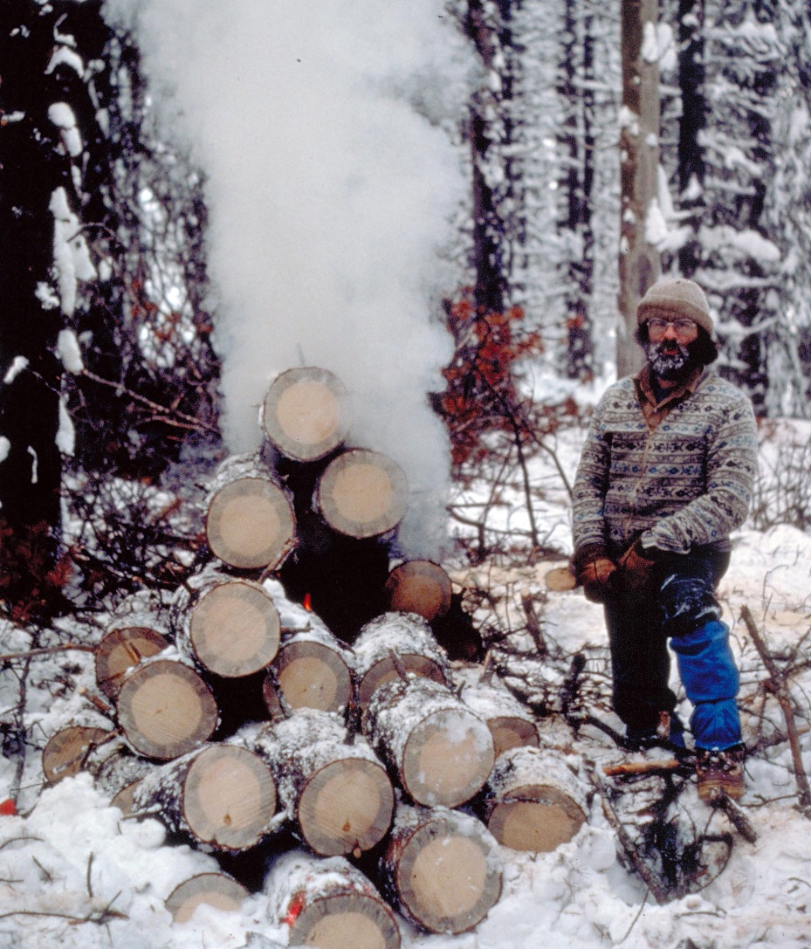
Mountain pine beetle management:
Fall and burn
Suppression BMUs only
small spots or patches in lightly infested areas
scattered attack on the periphery of larger infestations
areas with constraints
  resource values
  outside THLB.

Slide 44
Mountain pine beetle management:
Pheromone baits
“Temporary holding technique”.
Contain and concentrate beetles to facilitate sanitation harvesting.
In generally infested areas, apply at 50 m grid inside stand
Also spot bait in suppression BMUs
Works well at early incipient population levels, relatively inexpensive
Mandatory post-baiting follow-up (harvest).
Use in funnel traps to monitor flight periods.
Notes:
Beetle proofing has limited application because of conditional requirements.
Pheromone Baiting is used to:
1. Contain and concentrate beetles to facilitate sanitation harvesting
2. Enhance fall & burn treatments
3. Monitoring for hauling & milling restrictions
Advantages: Works well at early incipient population levels & relatively inexpensive
Disadvantage: Mandatory post-baiting follow-up

Slide 45
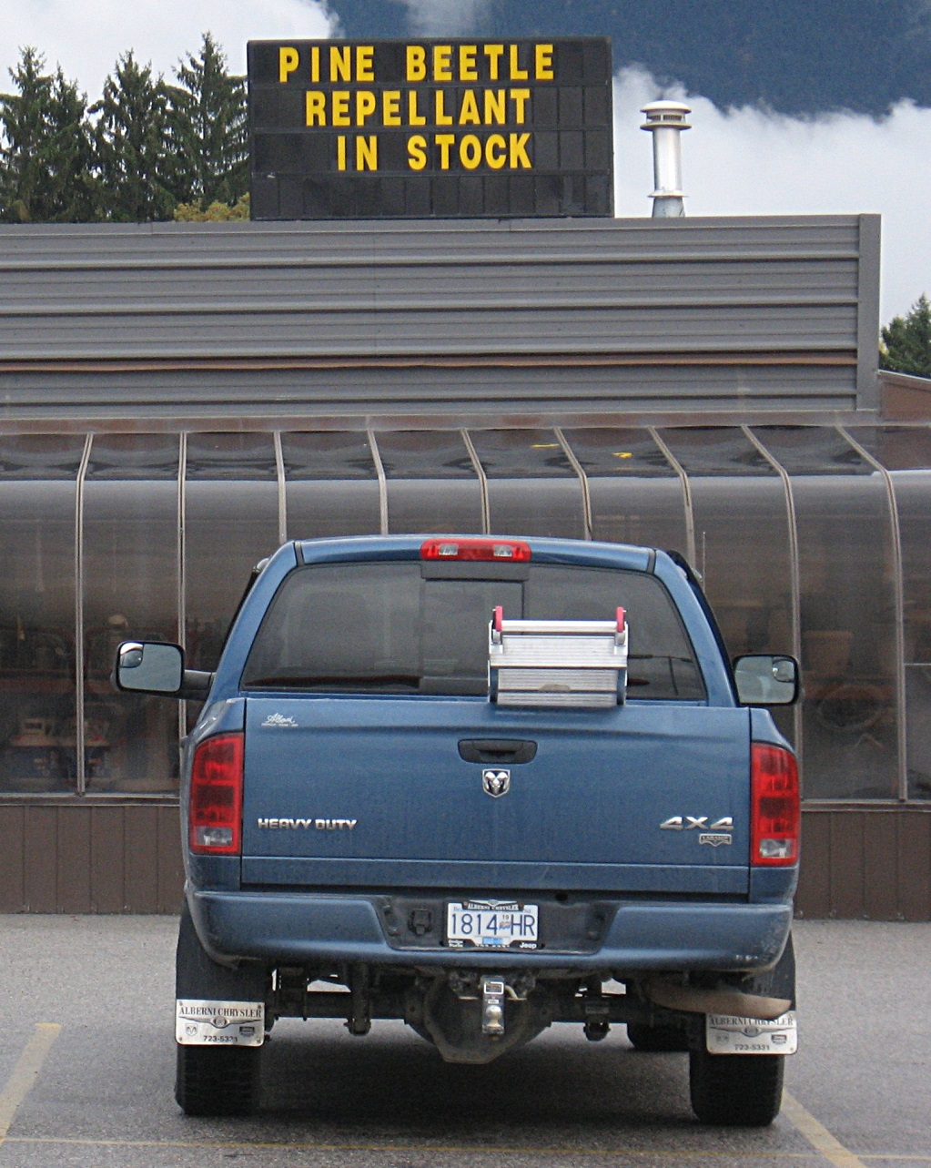
Mountain pine beetle management:
”Antiaggregation” verbenone
Individual-tree protection is
usually 80% or greater, 2/tree.
Area protection short term 2-3 yrs,
declines as local adjacent
populations increase.
Apply 75-100/ha where MPB
<= 15% of stand
Push-pull?
High value areas…
Expensive.
Notes:
trimethyl-bicyclo-heptenone
Most of the time, individual-tree protection is good—typically 80% or greater. “Area” protection seems to be less so.
Current Recommendations for Using Verbenone (Including above-noted caveats!)
1. Area and/or stand to be treated should be assessed for both hazard (susceptibility) and risk (likelihood of infestation) to MPB. If more than 15% of the stand (trees per acre or basal area—whichever stocking measurement is more conveniently obtained) is occupied by currently infested trees, and those trees cannot be removed prior to beetle flight; do not use verbenone—results may not be worth the cost of treatment.
2. For individual-tree protection, use two 7- or 7.5-gram pouches per tree. Staple (through the strip provided) on northeast and northwest side of tree, as reasonably high as one can reach. In recreation or high-use areas, we suggest attaching them about 10 feet from the ground—easily accomplished with something like a roofing hammer. For larger trees (>24” d.b.h.) use 3-4 pouches per tree, stapled equidistantly around tree’s circumference.
3. For area protection, recommendations vary with nearby beetle populations. We have achieved reasonably good protection (70-80% protection when compared with untreated controls) using as few as 20 pouches per acre and as many as 40 pouches per acre. In areas where beetle populations are lower (less than 15% infestation rate in surrounding stands), 20 pouches per acre will likely give good protection. If higher than about 30%, 40 pouches per acre will give better protection. For 20 pouches per acre (50/ha), place on approximate 47-feet (14m) grid; for 30 (75/ha), about a 38-feet (12m) grid; for 40 (100/ha), 33-feet (10m) grid.
4. Keep in mind, area protection may decline as beetle populations increase in a particular area. Area protection should be considered a “time-buying” measure intended to be effective for only 2-3 years.
5. Verbenone pouches should be in place in lower-elevation stands by July 1. MPB flight in most years, in most host stands, occurs from about mid-July to late-August (occasionally early September). In high-elevation WBP stands, we often encounter MPB life cycles of varying lengths, and sometimes beetle flight as early as late-May. For treating WBP, we recommend treatments be in place by the latter part of May.
6. Verbenone is a fairly innocuous chemical—but it is still a chemical, and some care should be exercised in its use. Manufacturers recommend using chemical-resistant gloves when applying and any other safety equipment typically used in the field. Care should be taken to follow all precautions found on registration label.

Slide 46
Mountain pine beetle management:
Pheromone push-pull
PUSH - Treat high value stand/spots with verbenone antiaggregation pheromone
PULL - Contain and concentrate beetles in target stand with tree baits, then harvest.
Notes:
Beetle proofing has limited application because of conditional requirements.
Pheromone Baiting is used to:
1. Contain and concentrate beetles to facilitate sanitation harvesting
2. Enhance fall & burn treatments
3. Monitoring for hauling & milling restrictions
Advantages: Works well at early incipient population levels & relatively inexpensive
Disadvantage: Mandatory post-baiting follow-up

Slide 47
Mountain pine beetle management:
Topical insecticides - Carbaryl
Pre-attack application, apply annually to high value trees to kill incoming beetles.
Post-attack application on infested trees to kill emerging beetles.
Notes:
Beetle proofing has limited application because of conditional requirements.
Pheromone Baiting is used to:
1. Contain and concentrate beetles to facilitate sanitation harvesting
2. Enhance fall & burn treatments
3. Monitoring for hauling & milling restrictions
Advantages: Works well at early incipient population levels & relatively inexpensive
Disadvantage: Mandatory post-baiting follow-up

Slide 48
Mountain pine beetle management:
Beetle proofing
Use in stands with <= 10% infestation.
Thin from below, at 4 – 5m spacing. Spacing is critical.
Will maintain forest cover for 10-25 yrs.
  - watersheds, VQO, parks, wildlife, fisheries .
Limited applicability (numerous conditions apply: slope, dbh, initial stand density,…).
Notes:
Conditions for beetle proofing.
<= 35% Slope: to limit residual stand damage;
Average dbh >20 cm, with fewer than 865 trees per ha > 12.5 cm dbh;
>= 60 and <= 125 years old;
Sheltered slope positions in relation to topography and prevailing wind patterns.
Current infestation rate of 10% or less.
Live crown ratio >= 30%, no root disease or dwarf mistletoe problem; and
Meets Landscape Level Management Objectives.

Slide 49
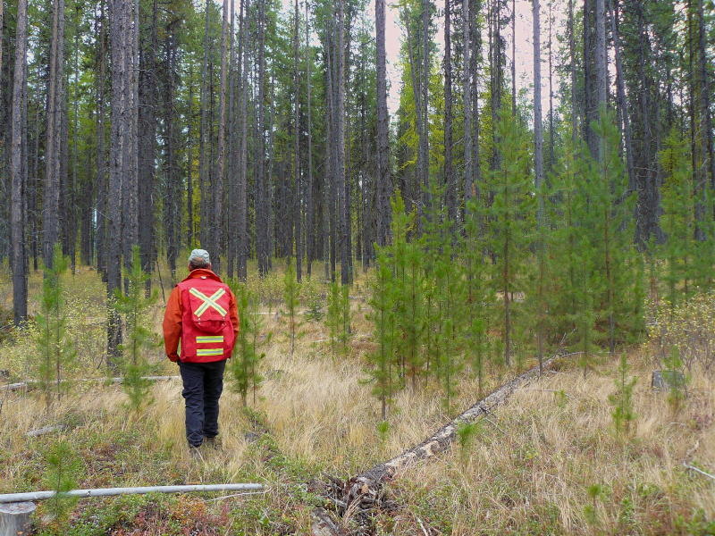
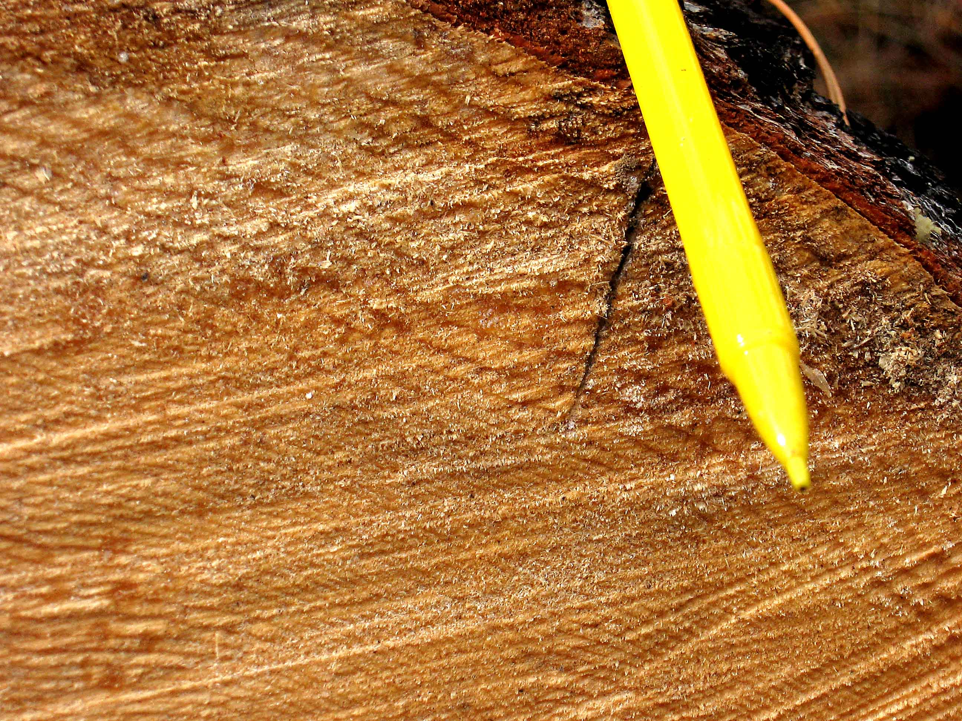
100 yrs old,
4x4m spaced
1992 (photo 2008)
Response to thinning

Slide 50
Mountain pine beetle management:
Other tricks
Pine removal
Small scale salvage
Debarking
Hauling & Milling Restrictions, hot milling
Management of infested waste

Slide 51
Mountain pine beetle management options:
Summary
Sanitation Harvesting
  Fall & Burn, Fall & Peel, Heli-Burning
  Snip and skid pine removal
  Clearcut Blocks
Pheromone baits, Verbenone, push-pull
Beetle Proofing
Topical Insecticide
Hauling & Milling Restrictions, hot milling
Management of infested waste
Silvicultural strategies
Notes:
Beetle proofing has limited application because of conditional requirements.
Pheromone Baiting is used to:
1. Contain and concentrate beetles to facilitate sanitation harvesting
2. Enhance fall & burn treatments
3. Monitoring for hauling & milling restrictions
Advantages: Works well at early incipient population levels & relatively inexpensive
Disadvantage: Mandatory post-baiting follow-up

Slide 52
Mountain pine beetle management :
Conclusions
There have been significant IBM populations in RKB for at least 50 years
Aggressive management has been in place since at least late 1980s
There is still susceptible pine
Weather is not usually limiting for IBM
Topography and mixed stands work in our favour

Slide 53
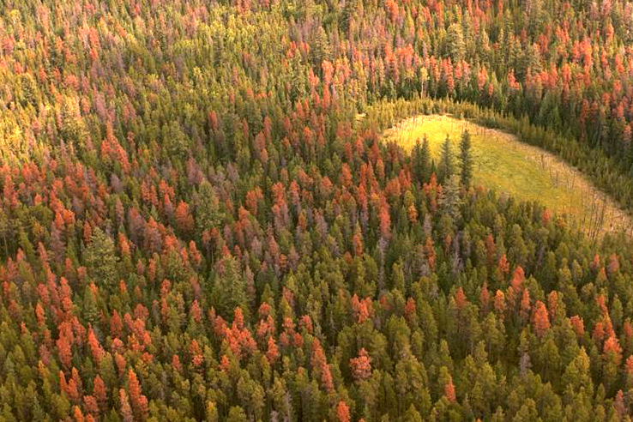
?s

Slide 54
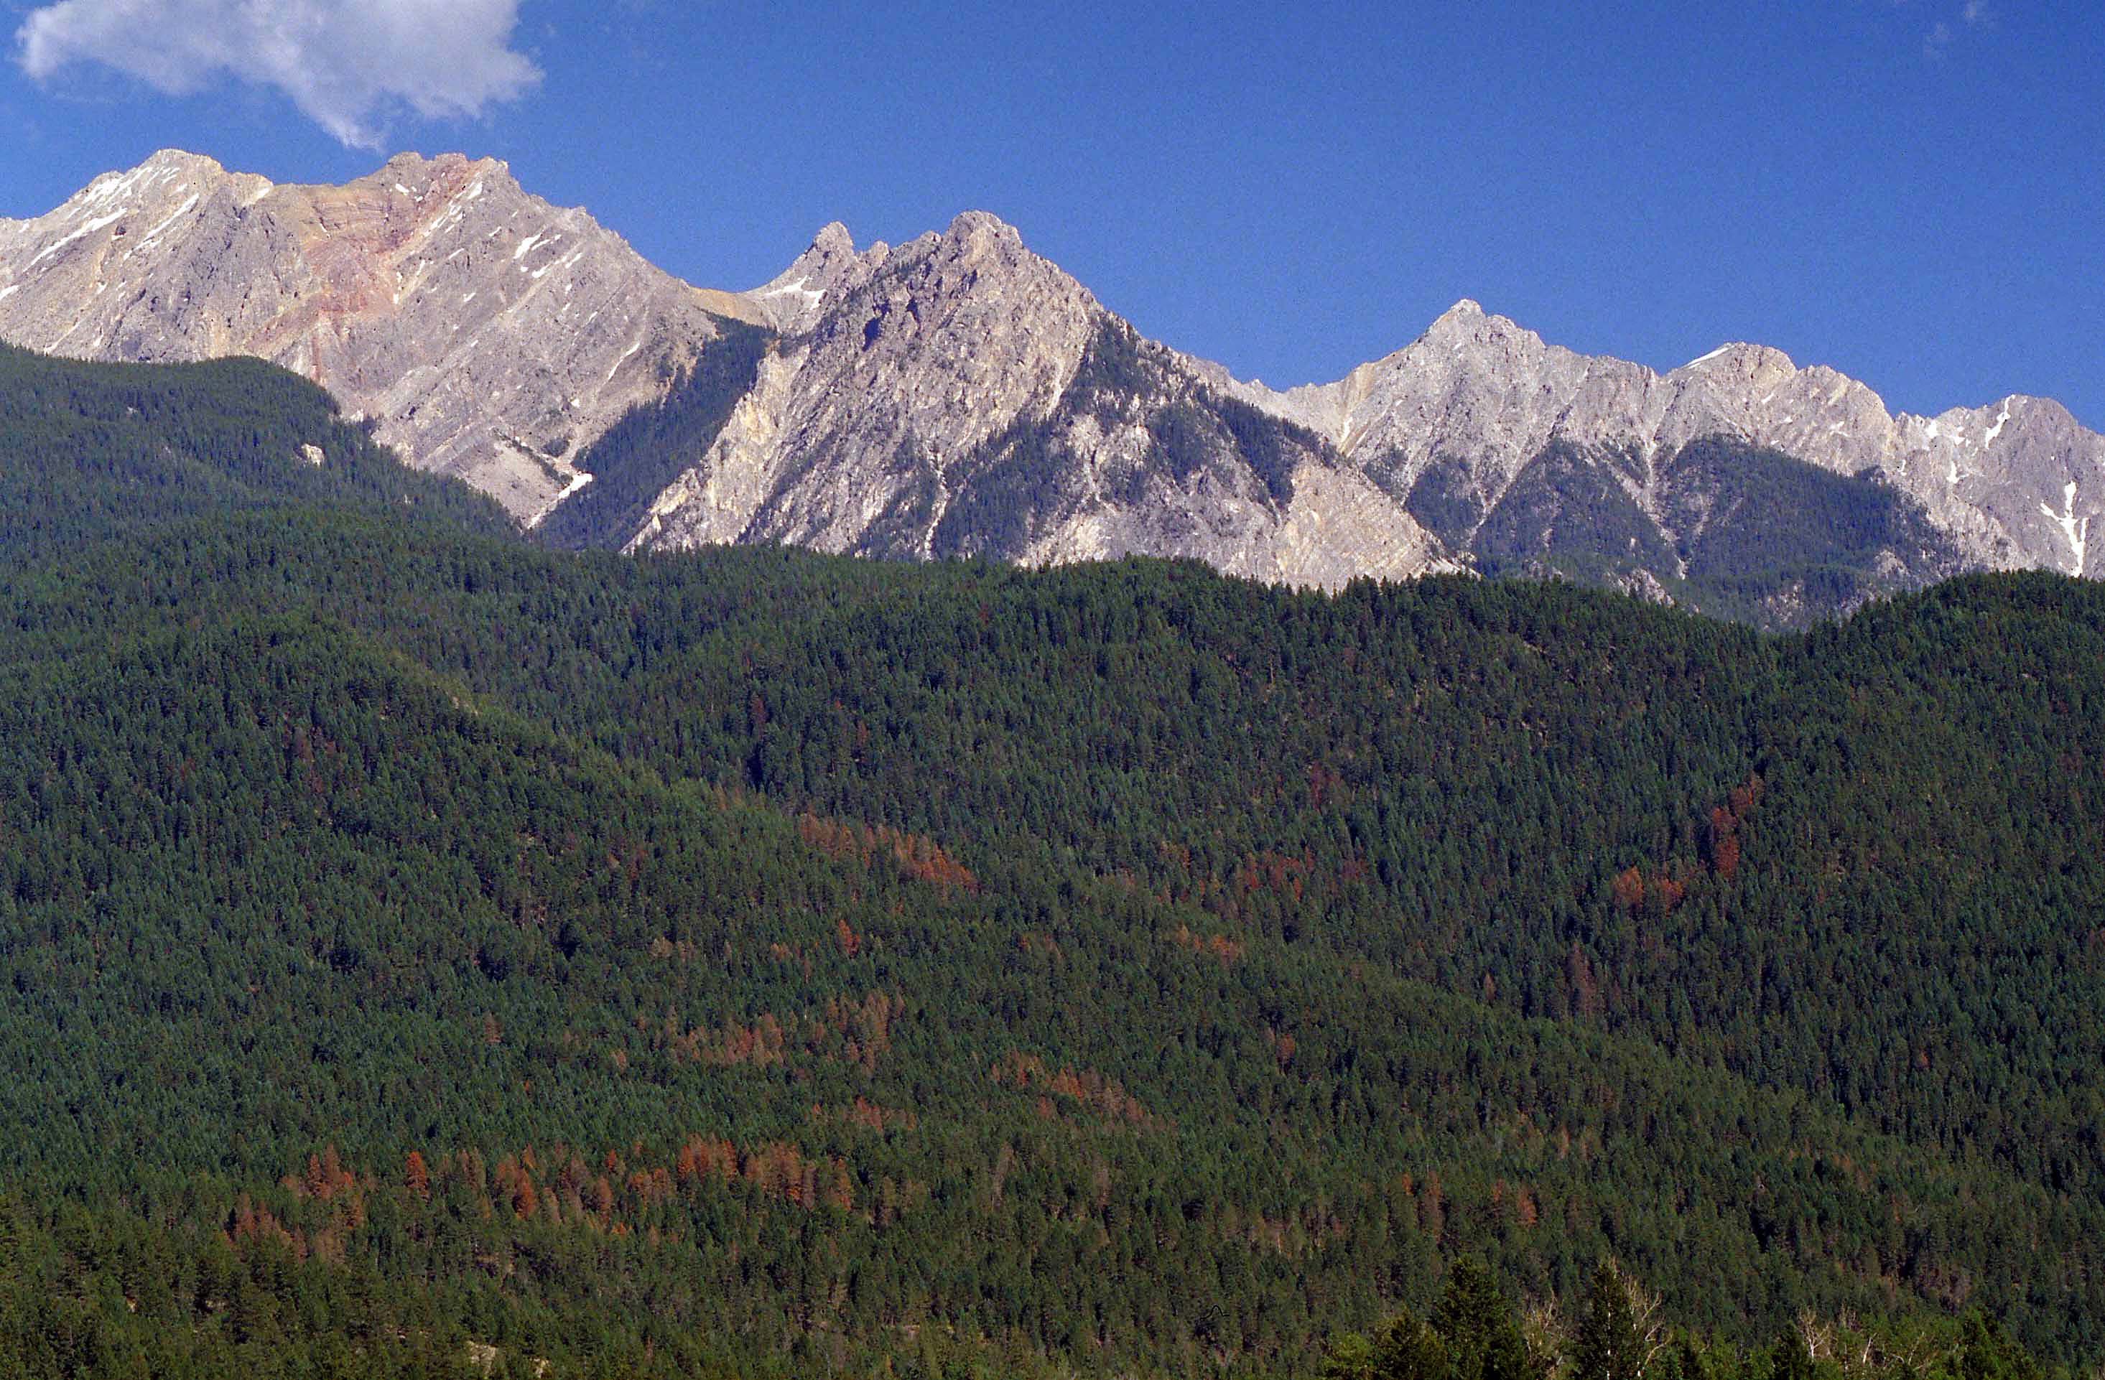
Douglas-fir beetle,
Dendroctonus pseudotsugae (Hopk.)

Slide 56
Notes:
IBS mostly DIN (3745), DGO (1070)

Slide 57
Douglas-fir beetle: Life cycle
Overwinters as (mostly) young adults, some mature larvae (20%)
Overwintering larvae emerge later in summer.
Flight begins in early May (April), continues through July (August)
  Ambient temperature ≥ 18°
Preferred host is recently moribund material, Douglas-fir or larch

Slide 58
Douglas-fir beetle: Endemic populations
Then:
Widely scattered small spots
1-5 trees centered around recent disturbance
Windthrow, lightning, root disease, drought
Now:
As above, but also dry rocky sites and rich wetter sites, with high levels of cumulative damage. Therefore, high background population levels.

Slide 59
Douglas-fir beetle: Incipient populations
Population buildup usually follows:
  large accumulations of windthrow, snow breakage, logging debris,
  Douglas-fir tussock moth defoliation (also spruce budworm?),
  fire damaged trees,
  (drought?)
Subsequent attack on standing trees, generally larger, older trees

Slide 60
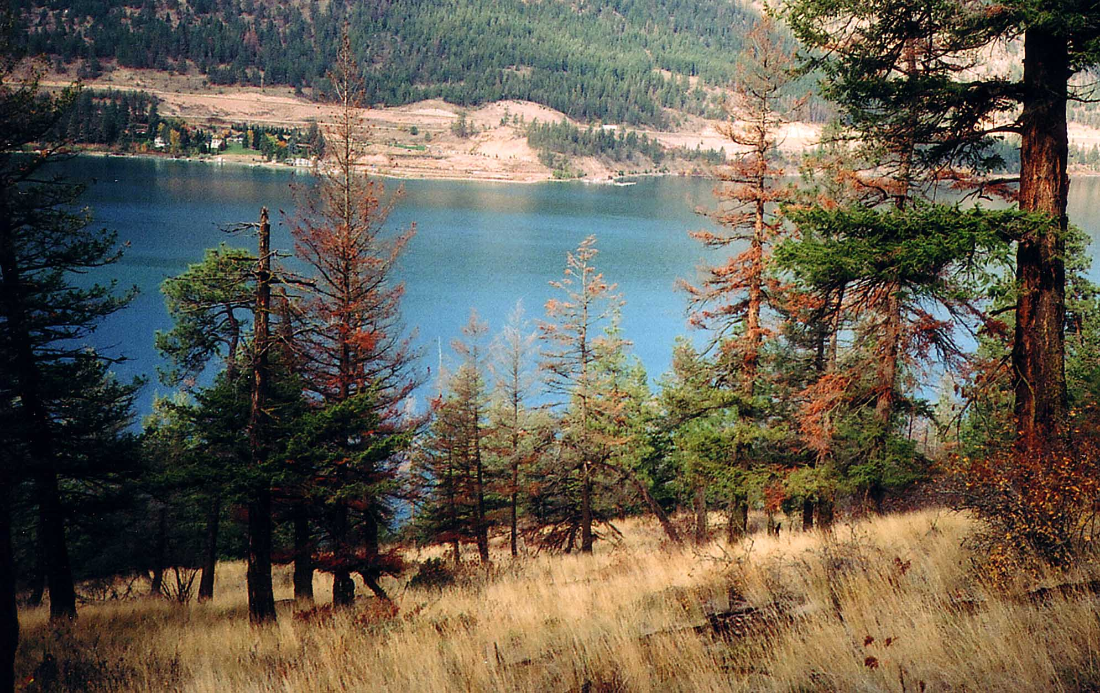
Drought kill and DFB, Kalamalka Lake

Slide 61
Blowdown in winter 1996 absorbed most beetles = few mapped reds in 1997
Notes:
Endemic situation has relatively few small spots, and few large polygons
Outbreaks have more polygons, and bigger polygons
Blowdown in winter 1996 brought in many beetles, and consequently there were few polygons in 1997…

Slide 62
Douglas-fir beetle:
Course of an infestation
Reductions in Douglas-fir basal area 40-70 percent
Duration of attack cycle
  Possibly 6-10 years in south-east BC, 5 years in central BC.
Notes:
For western Montana/northern Idaho, for Douglas-fir stands of otherwise high-hazard conditions this formula can be used to approximate anticipated beetle-caused tree mortality.
DF mortality = 13.2 + 0.33(DF basal area) (not converted to metric)

Slide 63
Douglas-fir beetle management:
Survey issues
Of trees with frass on the bole, 88% will be successfully attacked.
Only 30 % of trees will have attack at DBH (maybe more in in dryer vs. wetter BECs?).
Attack is best estimated using frass above 2 m, and considering woodborers at dbh as indicators on green trees.
Look up for pitch streams, frass.
June-Sept is best: More frass is more visible.

Slide 64
Douglas-fir beetle and clerid catch in baited funnel traps, as as cumulative percent of annual total, May - August 2014, Pend D'Oreille area, Arrow TSA.
16 July
Early!

Slide 65
Douglas-fir beetle and clerid catch in baited funnel traps, as cumulative percent of annual total, May - August 2015, Pend D'Oreille area, Arrow TSA.

Slide 66
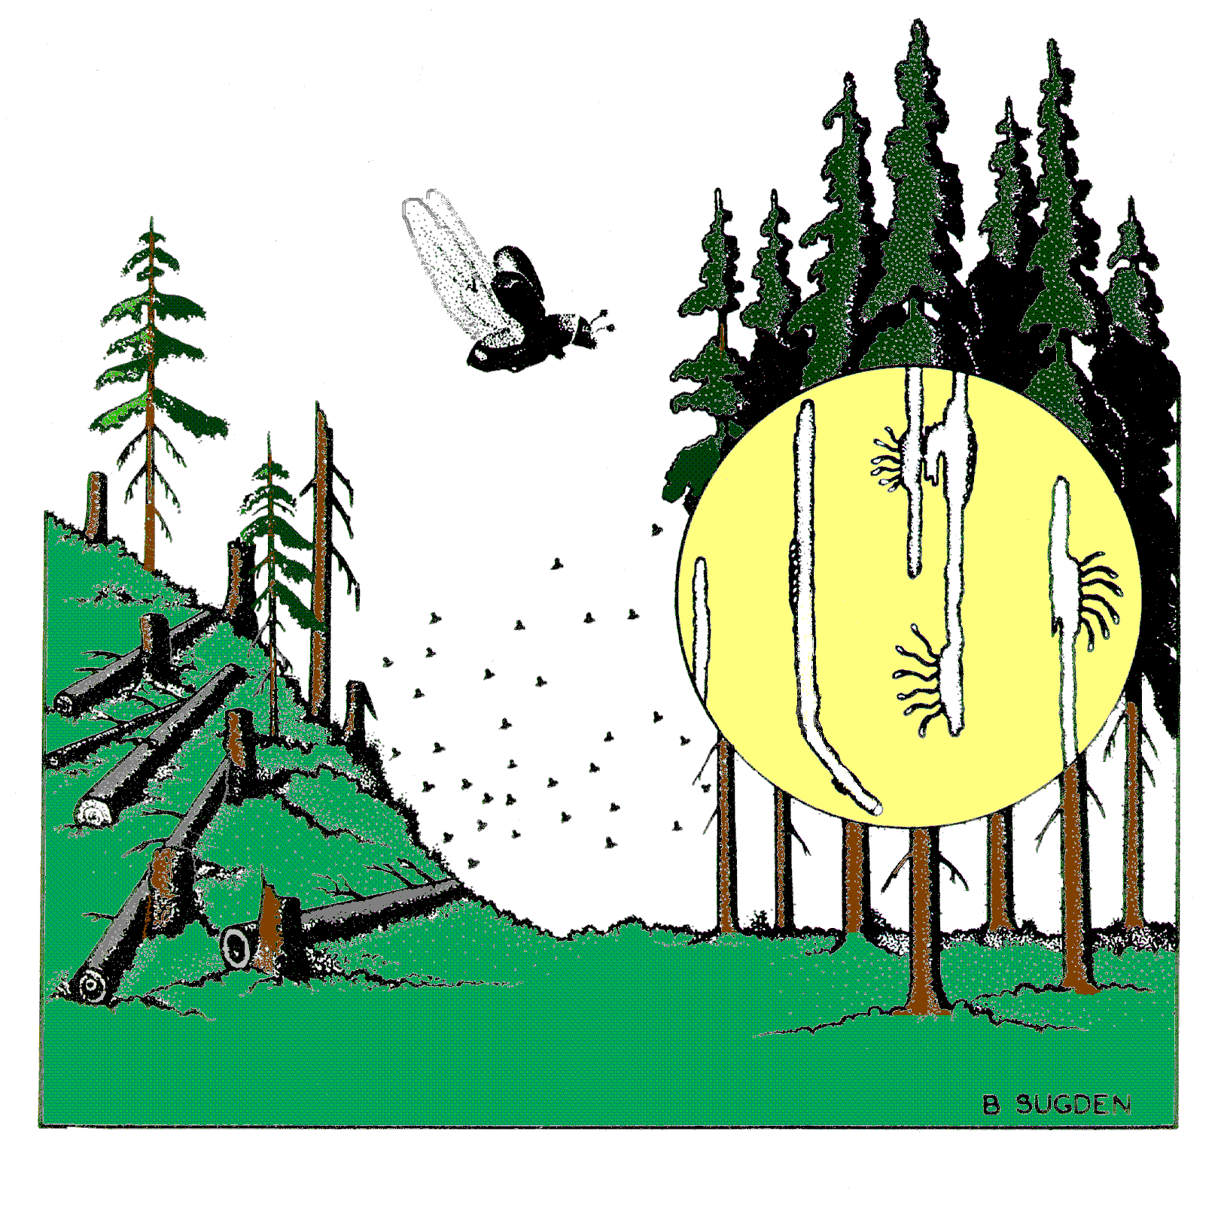
Douglas-fir beetle management:
Clean up!
Piece size? ANY SIZE!
Cut to length debris?
Attack on standing trees
Wind or snow damage
Slash and high stumps
Felled or blowdown

Slide 67
Douglas-fir beetle management: Harvesting infested blocks
Tree baits?
Low stumps.
Avoid damage to residual trees.
Remove infested debris
No long butting
Hot mill if appropriate.

Slide 68
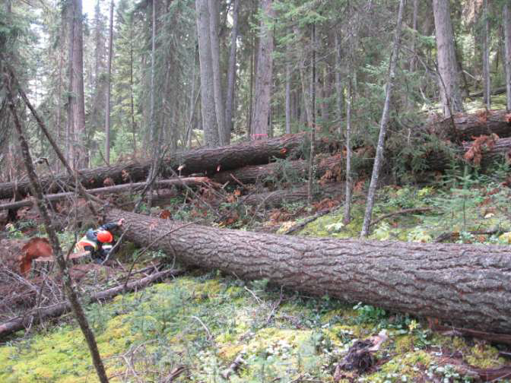
Douglas-fir beetle management: Trap trees
Largest available healthy trees
Shaded, not limbed or bucked
Can saturate in 20-30 days
Spillover only if traps touch
standing trees?
♀ (♂)
1 trap for every 4 to 10
infested trees
Max radius = 400m
Harvest, peel or burn
Notes:
Photo Nathon Voth

Slide 69
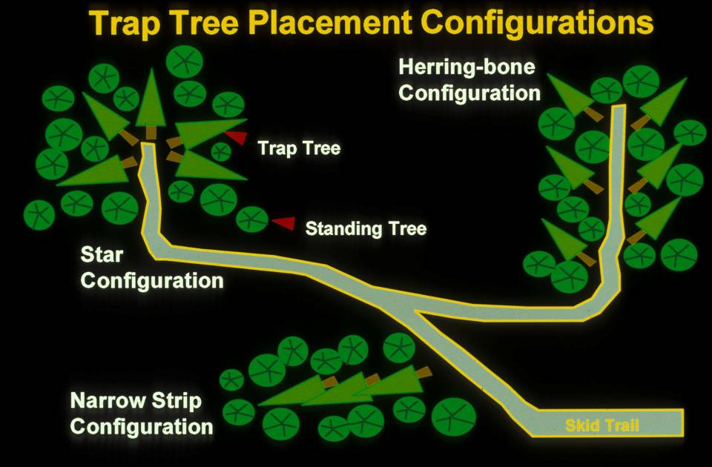
Douglas-fir beetle management: Trap trees

Slide 70
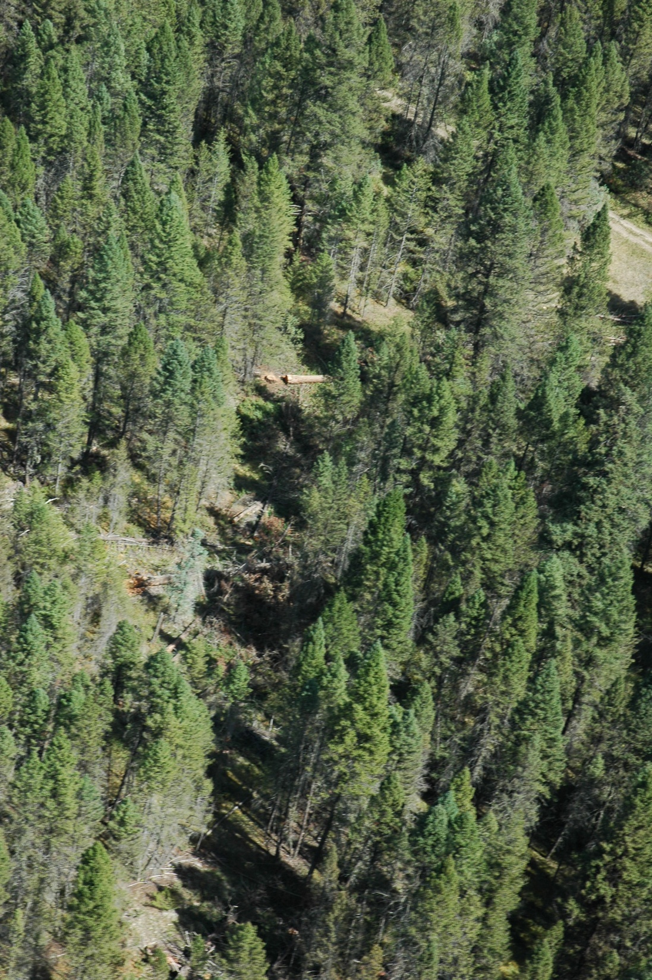
Good Trap Tree Site
Fall in shade
One trap tree for every 4 to 10 current attack
Pre-fell skid trails, landings, roads.
Notes:
Photo courtesy of Leo Rankin

Slide 71
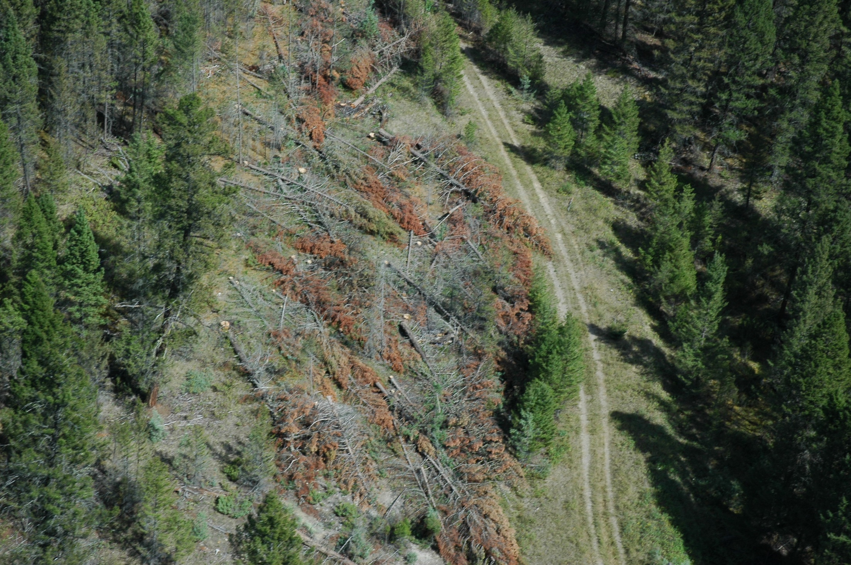
Poor Trap Tree
Site
Douglas-fir beetle management: Trap trees
Exposed to direct sun
Too hot and dry
Notes:
Photo courtesy of Leo Rankin

Slide 72
Douglas-fir beetle management:
Trap decks
Attack density same as single trap trees so catch depends on size of deck
Can saturate
Creating large gaps may increase sun exposure
Place at shaded edges
Minimal spillover, but check

Slide 73
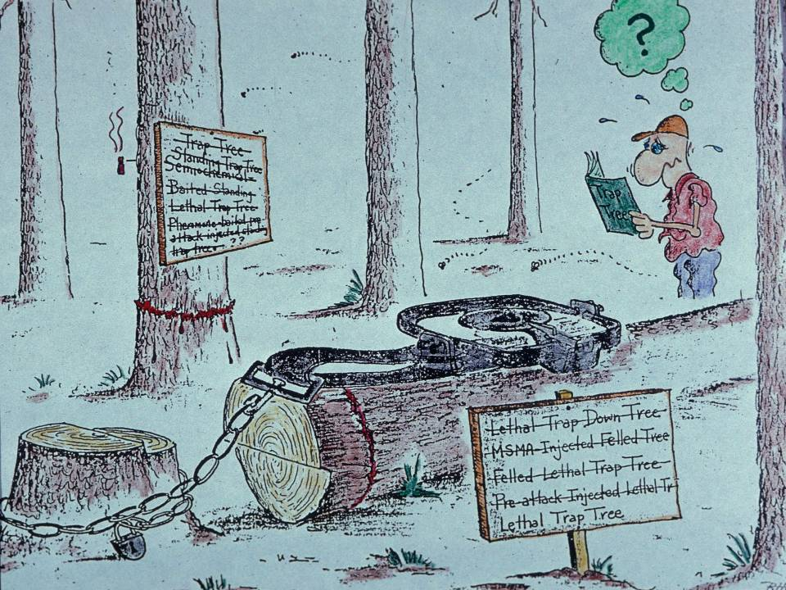
Fall 01 Nov – 31 Mar
Mark for recovery!
Maintain shade (& limbs)

Slide 74
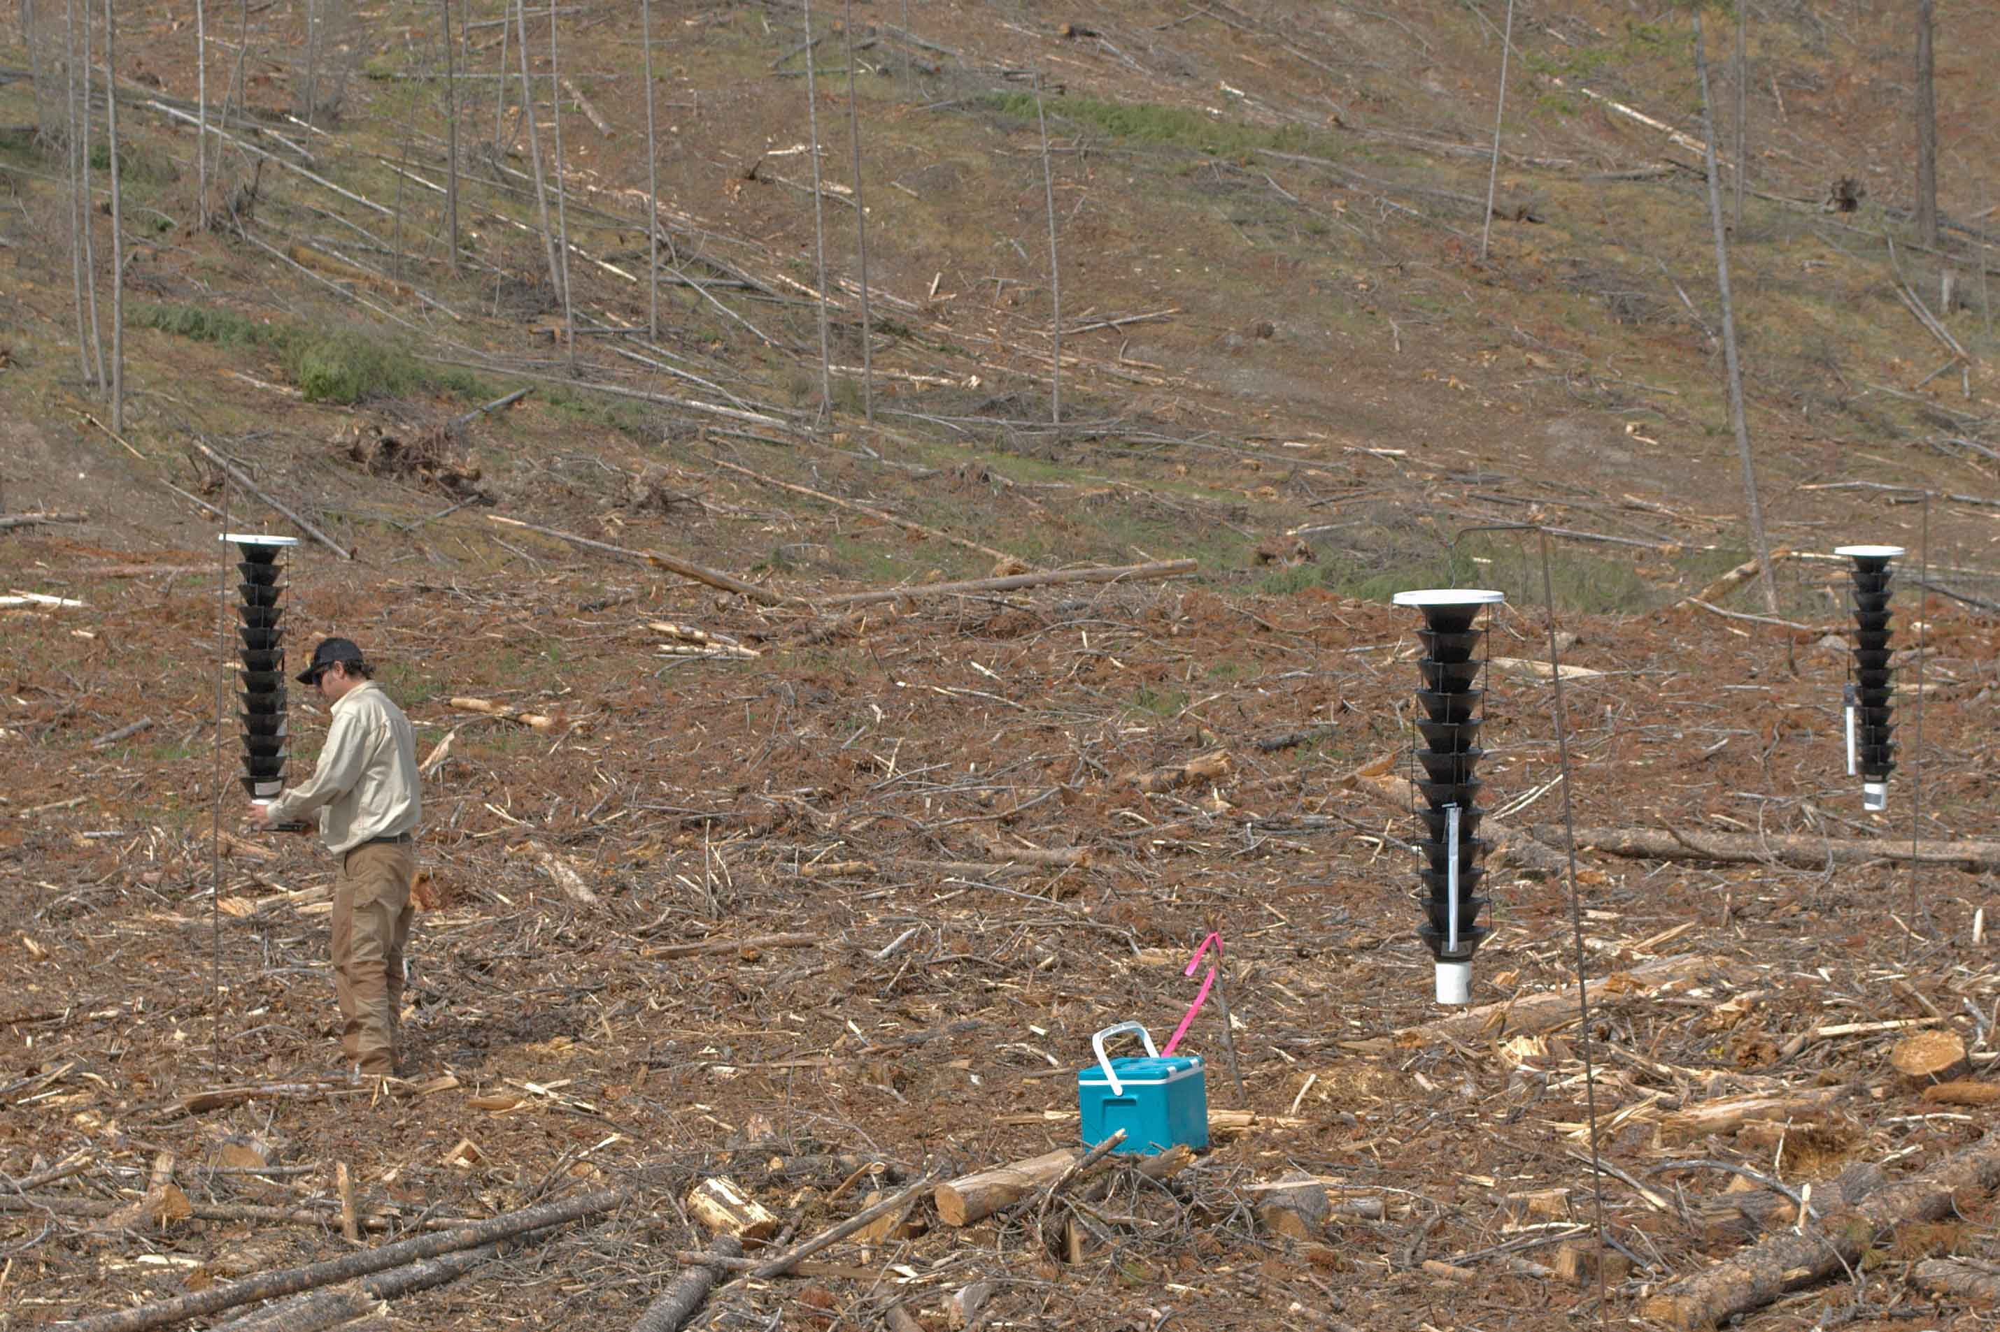
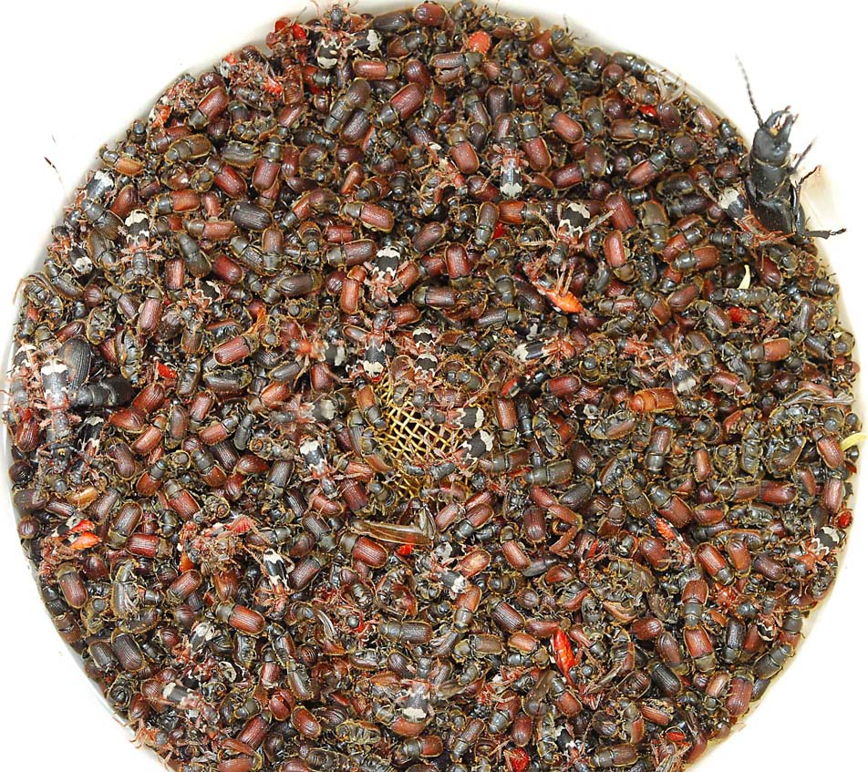
Douglas-fir beetle management:
Funnel trapping
♂(♀ )
Can run all summer
Catch is 2 to 3 x trap trees
Spillover!!
100m from live Fd
Maintain bi-weekly
New baits mid-June (?)
Protect residual trees with MCH
(200m)

Slide 75
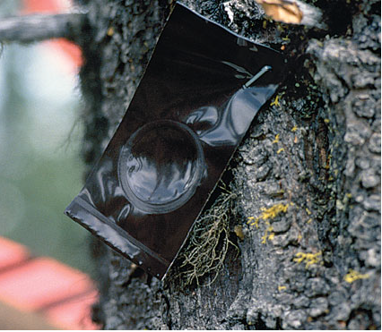
Douglas-fir beetle management: Repellent (MCH)
High value trees
or stands; maintain
timber value
Blowdown
Seed trees near
funnel traps
Easy to apply,
effective.
NOT PARKS!

Slide 76
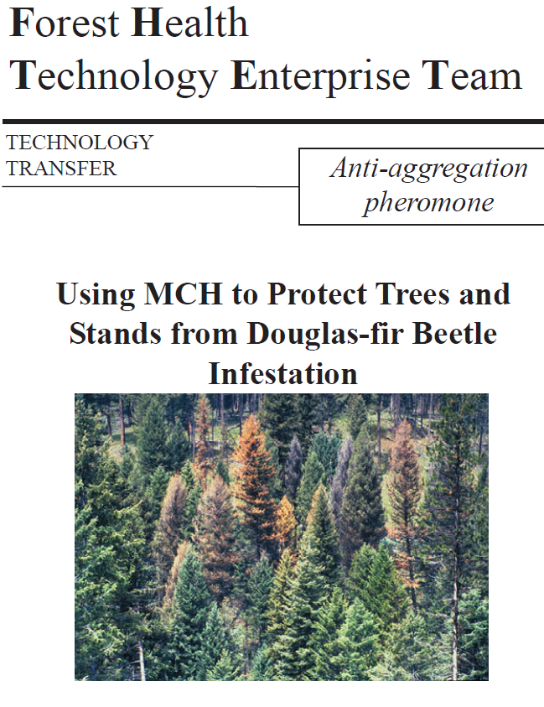
Douglas-fir beetle management: Repellent (MCH)

Slide 77
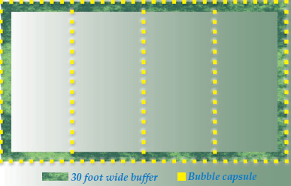
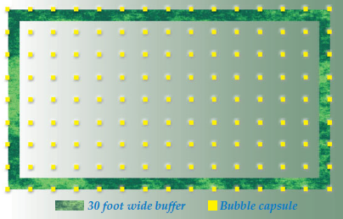
Douglas-fir beetle management:
Repellent (MCH)
Perimeter/line:
Capsule spacing 4.5m Line spacing 35-50m
(not to scale).
Grid at 12m spacing

Slide 78
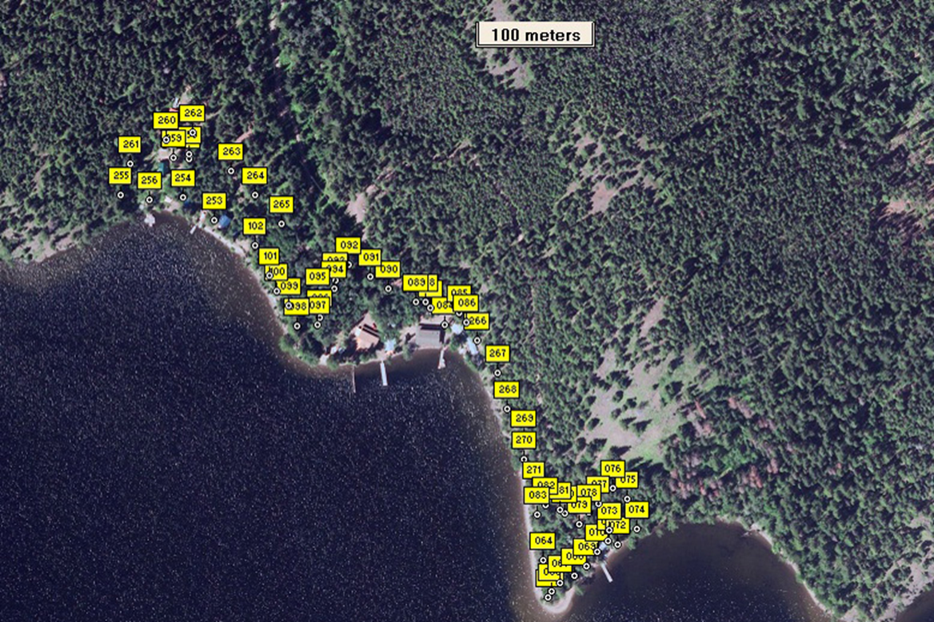
Douglas-fir beetle management:
Repellent (MCH)
Next to cottages from 2011 to 2014 with 100% success.
Notes:
We used MCH repellents next to cottages from 2011 to 2014 with 100% success in preventing DFB attack on standing Fdi. In cases with a known adjacent population of DFB, we also felled trap trees nearby on the Crown Land to attract the beetles.

Slide 79
Douglas-fir beetle management:
Tree Baits
For concentration and containment of infestations.
50 x 50m grid
HOT!! use only if clear-cuts are guaranteed.

Slide 80
Douglas-fir beetle management:
Pheromone push-pull
PUSH - Treat high value stand with MCH antiaggregation pheromone
PULL - Contain and concentrate beetles in adjacent target stand with tree baits, then harvest OR
  Trap trees nearby OR
  Funnel traps nearby
Notes:
Beetle proofing has limited application because of conditional requirements.
Pheromone Baiting is used to:
1. Contain and concentrate beetles to facilitate sanitation harvesting
2. Enhance fall & burn treatments
3. Monitoring for hauling & milling restrictions
Advantages: Works well at early incipient population levels & relatively inexpensive
Disadvantage: Mandatory post-baiting follow-up

Slide 81
Douglas-fir beetle management summary
Harvest, hot mill, manage debris and blowdown
Trap trees
  Most effective in reducing DFB population
  Least cost
  Fall Douglas-fir in spring & harvest them in fall / winter
Funnel traps
  Time commitment to maintain during the summer
  Use to reduce DFB populations if inoperable or no trap tree opportunity
Repellent MCH
  Protect seed trees, UWR, trees near funnel traps
  Minimal cost
  Reduced risk of losing high value Douglas-fir

Slide 82
Douglas-fir beetle management planning
Falling trap trees – by April 15
Deploying repellents – April 4 to 15
Deploying funnel traps – April 4 to 15
Maintaining funnel traps – April to August
Surveys – July to mid-September
Check aerial survey records for new infestations and blowdown
Harvesting beetle attacked trees – fall/winter
Deal with trap trees – harvest, peel, burn
Repeat

Slide 83
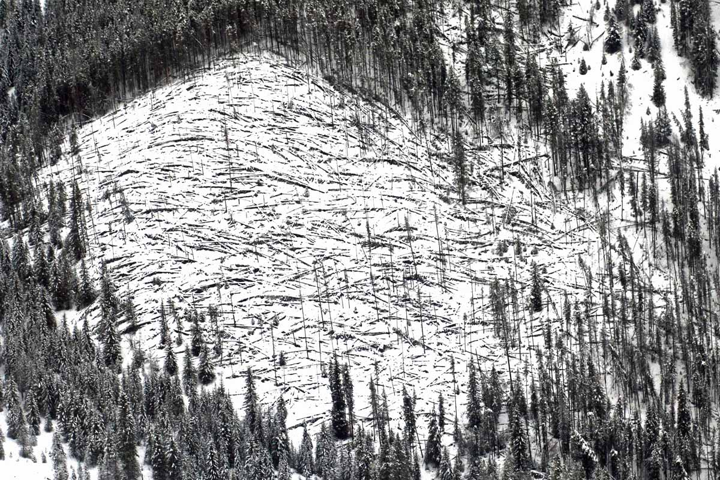
?s

Slide 84
Spruce Beetle
Curculionidae: Scolytinae
Dendroctonus rufipennis (Kirby)

Slide 86
Notes:
IBS mostly DIN (3745), DGO (1070)

Slide 87
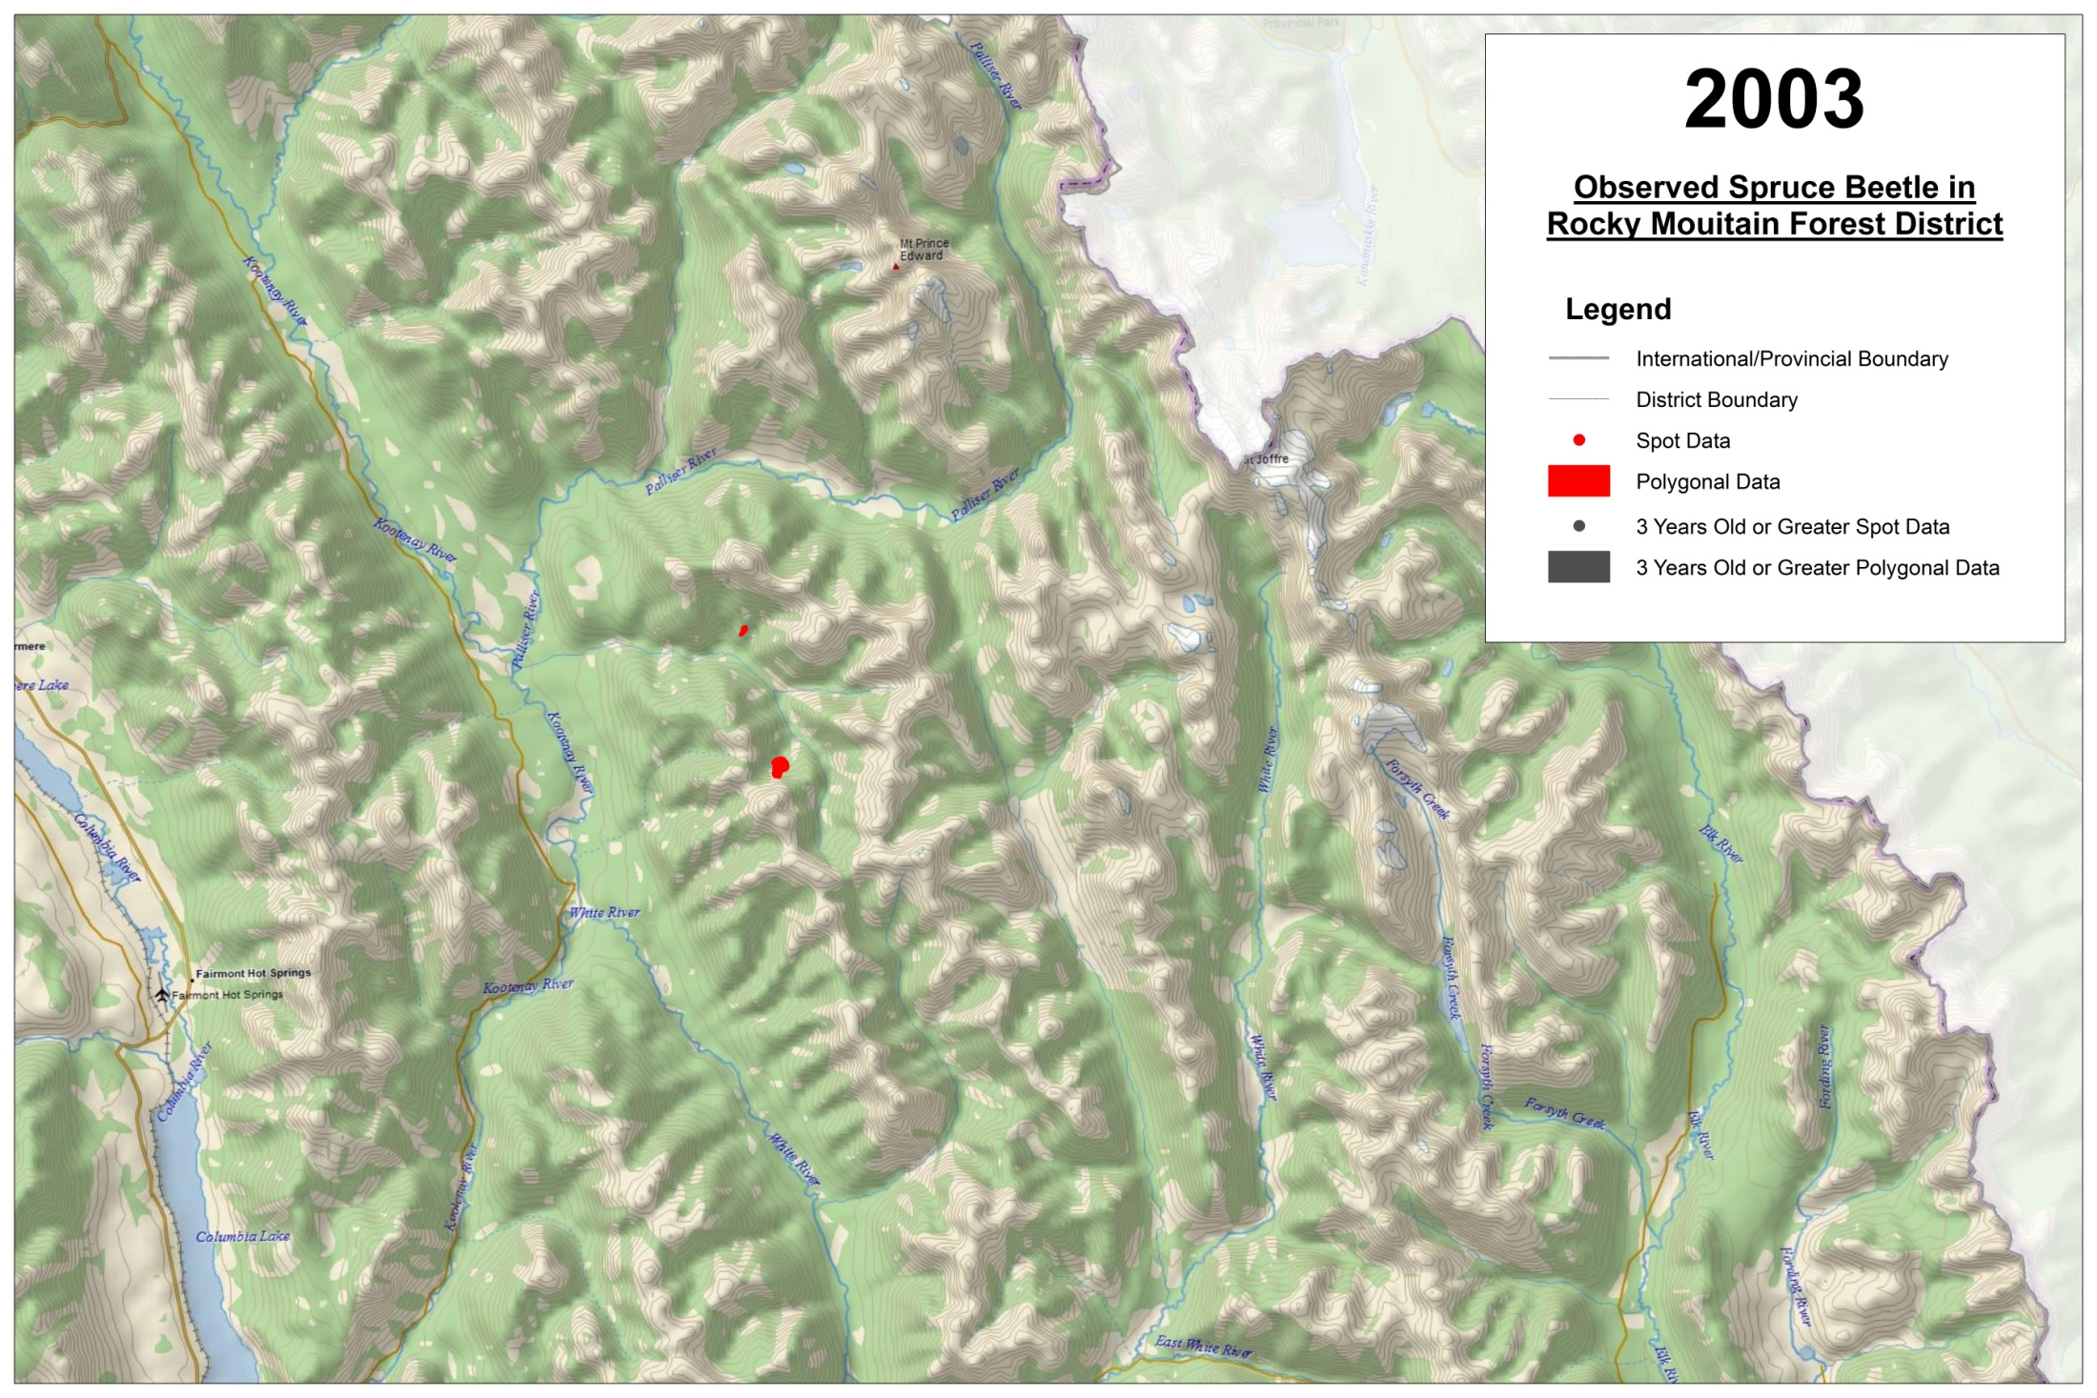
Notes:
IBS DRM aerial overview 2003-2014, areas turn grey after 3 years.

Slide 88
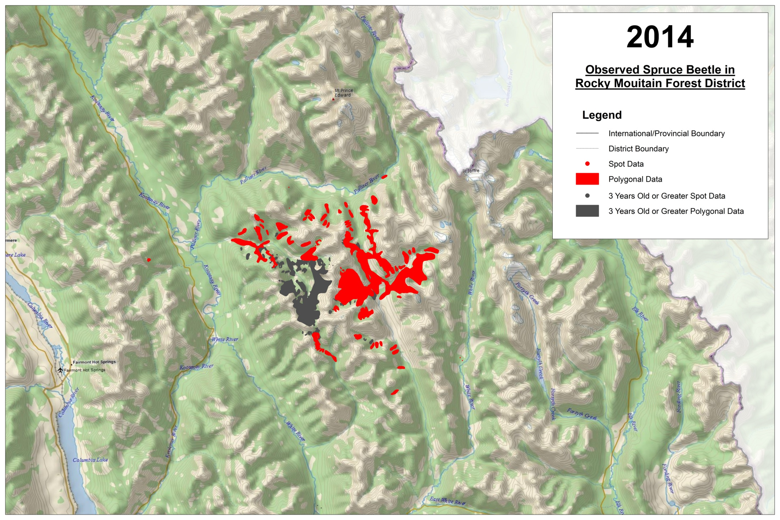

Slide 89
Spruce beetle: Life cycle
A two-year cycle is normal
Some portion of the population will complete life cycle in one year.
A three-year cycle can occur
Spruce beetles must overwinter as new adults before they can fly and attack trees.
New adults will emerge from standing attacked trees to overwinter at the base of the tree, around the root collar. Emergence begins with the onset of cooler weather in August.
Few adults emerge from windfall or slash to overwinter.
Notes:
ADULTS fly after temperatures reach 65°F (16°C) in the spring.
The heaviest infestations are concentrated in the lower 10 m of standing trees.
Spruce beetle EGGS AND PUPAE are not hardy enough to survive overwinter.
Spruce beetles must overwinter as NEW ADULTS before they can fly and attack trees.
In a standing attacked tree, NEW ADULTS WILL EMERGE AND OVERWINTER AT THE BASE OF THE TREE, AROUND THE ROOT COLLAR. This emergence begins with the onset of cooler weather, about September. Surveys conducted at this time may under estimate the number of beetles. Adults do not emerge from windfall or downed trap trees to overwinter.
Spruce cannot be reliably classified by foliage, because the needles frequently fall before any marked change in colour occurs.
All species of spruce in British Columbia are susceptible to spruce beetle attack, but outbreaks are rare in Sitka and black spruce.
A two-year cycle is normal, but there is usually some portion of the spruce beetle population which completes its life cycle in only one year. The difference between one and two year cycles is the percentage of the population on a one year cycle, rather than an obvious case of all of the beetles in one tree completing their development in only one year.
Cycle is temperature dependent. One-year cycle may be more common on upper bole or upper slopes due to temperature inversions. More common on south aspects, or south side of bole.
Hansen, E.M.; Bentz, B.J.; Turner, D.L. 2001a. Physiological basis for flexible voltinism
in the spruce beetle (Coleoptera: Scolytidae). The Canadian Entomologist. 133: 805-
817.
Hansen, E.M.; Bentz, B.J.; Turner, D.L. 2001b. Temperature-based model for predicting
univoltine brood proportions in spruce beetle (Coleoptera: Scolytidae). The Canadian
Entomologist. 133: 827-841.

Slide 90
Spruce beetle: Endemic populations
Stressed/damaged trees
Single fallen trees or very small spots

Slide 91
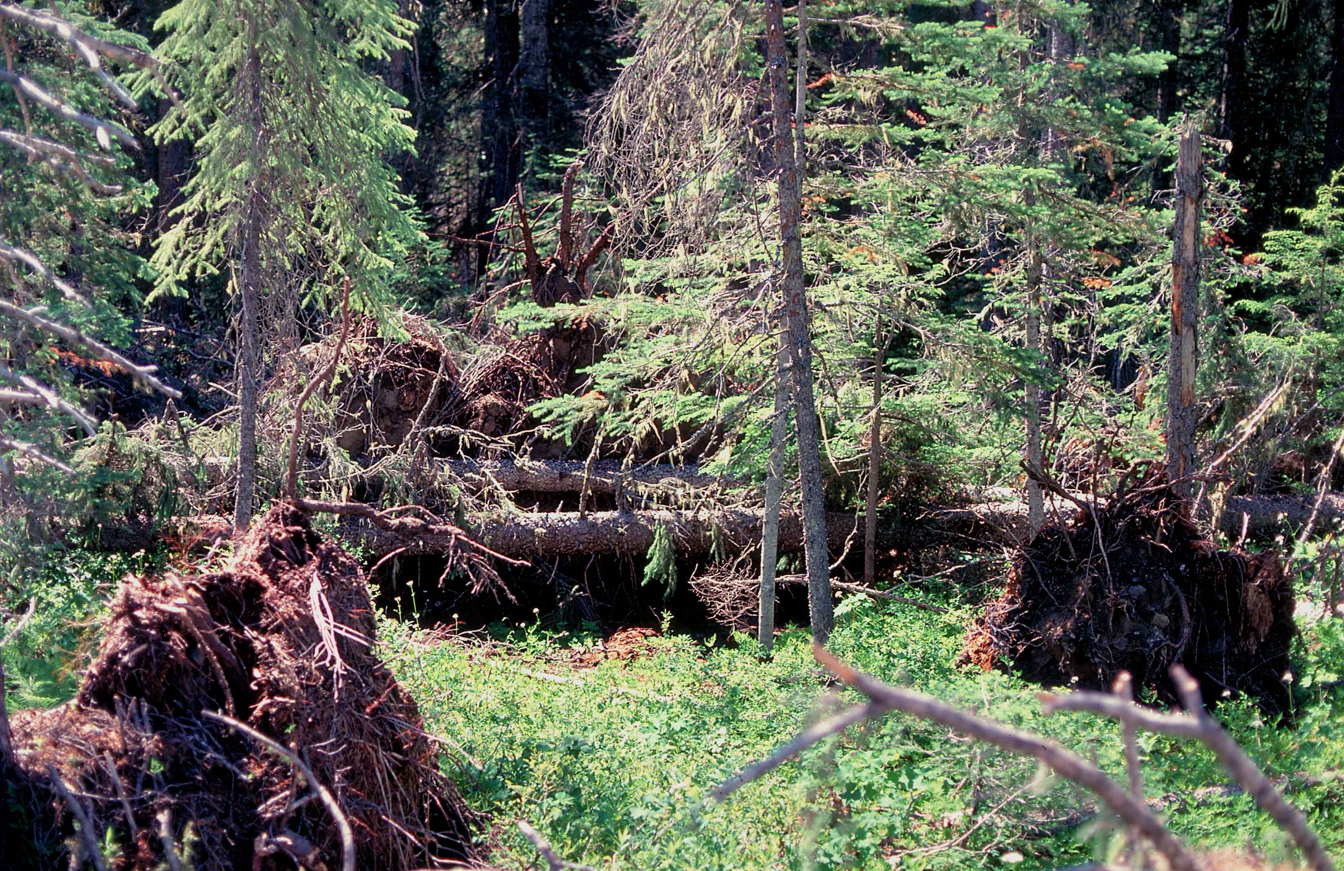
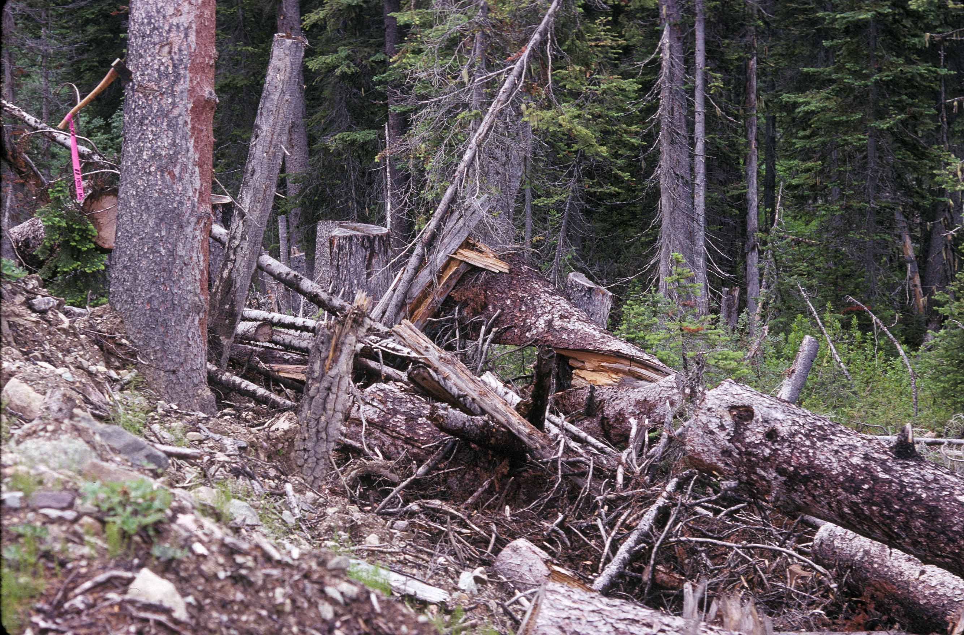
Spruce beetle host preferences –
Incipient (building) populations
Blowdown
Larger slash and
stumps
Climate change?
Notes:
Lang Ck 1992 (DGO). Roadside slash generates SB attack on adjacent trees
SBB populations are complex and, non-linear in nature. They exhibit shifts from endemic to epidemic levels that are
catalyzed by specific events and therefore not reliably predictable. Climate is a major driver. Relationships between forest structure, composition, site, and spruce beetle occurrence in the Intermountain West USDA Forest Service Proceedings – RMRS-P-56 2009

Slide 92

Palliser blowdown, aerial overview, 2012
It’s always worse than it looks?

Slide 93
Spruce beetle: Incipient to outbreak?

Slide 94
Spruce beetle:
Finding incipient populations?
The best approach may be to “scout”
Simple annual walkthroughs in:
  High hazard stands
  Stands with edge blowdown
  Known blowdown
  Debris piles

Slide 95
Spruce beetle: Course of an infestation
Outbreaks tend to appear over whole stands
Detection is almost always in second year of attack
Percent mortality can be variable, but primary focus trees are larger trees

Slide 96

Spruce beetle Management: Clean up!
Piece size? >= 20 cm diameter x >= 2 m length
Cut-to length debris?
Notes:
Cupola Ck 1992 (DGO). Hi stumps and slash generate SB attack in drainage (centre: Kevin Edquist)

Slide 97
Fall 01 Nov – 31 Mar
Mark for recovery!
Maintain shade (& limbs)

Slide 98
Spruce beetle Management:
MCH Repellent on downed trees
MCH is anti-aggregation pheromone of the spruce beetle
Has been used to reduce spruce beetle attack on felled trees
Inconsistent results on standing trees, not currently recommended.
Notes:
Pre-attack application of pheromones of competing beetle species has been used on downed trees to inhibit spruce beetle (SBB) attack and production, and allow secondary beetle species to successfully exploit the resource. These secondary beetles do not normally attack and kill healthy trees (Poland and Borden 1998). The treatment precludes development of SBB populations, but doesn’t actually directly kill many SBB.
MCH is anti-aggregation pheromone of the spruce beetle that has been used to reduce spruce beetle attack on felled trees, but has had inconsistent results on standing trees.
Treatment: Attract Ips tridens; ipsdienol @ 0.2 mg/day, and cis-verbenol 83:17 -:+ @ 0.6 mg/day (cis-verbenol perhaps not needed (Werner and Holsten 2002)?); plus
Attract Dryocoetes affaber; 1:1 racemic +/- endo-Brevicomin @ 0.2 mg/day; plus.
Repel SBB: standard available MCH device (Werner and Holsten 2002). Applying endo-B for D. affaber is probably sufficient.
Application: On blowdown: approximately 5 m spacing on -N- side of bole. Five m is an average of Poland and Borden 1998a and Werner and Holsten 2002.
On standing trees: one set of release devices on the north side of standing fire damaged trees.
References: Poland, T.M., and J.H. Borden. 1998. Competitive exclusion of Dendroctonus rufipennis induced by pheromones of Ips tridens and Dryocoetes affaber (Coleoptera: Scolytidae). J. Econ. Ent. 91:1150-1161.
Werner, R.A. and E.H. Holsten. 2002. Use of semiochemicals of secondary bark beetles to disrupt spruce beetle attraction and survival in Alaska. USDA Forest Service Research Paper PNW-RP-541.
Ross, D.W., G.E. Daterman, and A.S. Munson. 2004. Evaluation of the antiaggregation pheromone, 3-methylcyclohex-2-en-1-one (MCH), to protect live spruce from spruce beetle (Coleoptera: Scolytidae) infestation in southern Utah. J. Ent. Soc. British Columbia 101: 145-146.

Slide 99
Spruce beetle Management:
Competitive exclusion on downed trees
Pre-attack application of pheromones of competing secondary beetle species to promote exploitation of resource
Inhibits spruce beetle (SBB) attack and production
Has been used on downed trees
Attracts Ips tridens and Dryocoetes affaber
Expensive
Notes:
Pre-attack application of pheromones of competing beetle species has been used on downed trees to inhibit spruce beetle (SBB) attack and production, and allow secondary beetle species to successfully exploit the resource. These secondary beetles do not normally attack and kill healthy trees (Poland and Borden 1998). The treatment precludes development of SBB populations, but doesn’t actually directly kill many SBB.
MCH is anti-aggregation pheromone of the spruce beetle that has been used to reduce spruce beetle attack on felled trees, but has had inconsistent results on standing trees.
Treatment: Attract Ips tridens; ipsdienol @ 0.2 mg/day, and cis-verbenol 83:17 -:+ @ 0.6 mg/day (cis-verbenol perhaps not needed (Werner and Holsten 2002)?); plus
Attract Dryocoetes affaber; 1:1 racemic +/- endo-Brevicomin @ 0.2 mg/day; plus.
Repel SBB: standard available MCH device (Werner and Holsten 2002). Applying endo-B for D. affaber is probably sufficient.
Application: On blowdown: approximately 5 m spacing on -N- side of bole. Five m is an average of Poland and Borden 1998a and Werner and Holsten 2002.
On standing trees: one set of release devices on the north side of standing fire damaged trees.
References: Poland, T.M., and J.H. Borden. 1998. Competitive exclusion of Dendroctonus rufipennis induced by pheromones of Ips tridens and Dryocoetes affaber (Coleoptera: Scolytidae). J. Econ. Ent. 91:1150-1161.
Werner, R.A. and E.H. Holsten. 2002. Use of semiochemicals of secondary bark beetles to disrupt spruce beetle attraction and survival in Alaska. USDA Forest Service Research Paper PNW-RP-541.
Ross, D.W., G.E. Daterman, and A.S. Munson. 2004. Evaluation of the antiaggregation pheromone, 3-methylcyclohex-2-en-1-one (MCH), to protect live spruce from spruce beetle (Coleoptera: Scolytidae) infestation in southern Utah. J. Ent. Soc. British Columbia 101: 145-146.

Slide 100
Spruce beetle Management:
Preventing emergence by early falling of infested trees
Overwintering hibernation emergence of adults from standing trees can be prevented by falling the infested trees before August.
Notes:
Pre-attack application of pheromones of competing beetle species has been used on downed trees to inhibit spruce beetle (SBB) attack and production, and allow secondary beetle species to successfully exploit the resource. These secondary beetles do not normally attack and kill healthy trees (Poland and Borden 1998). The treatment precludes development of SBB populations, but doesn’t actually directly kill many SBB.
MCH is anti-aggregation pheromone of the spruce beetle that has been used to reduce spruce beetle attack on felled trees, but has had inconsistent results on standing trees.
Treatment: Attract Ips tridens; ipsdienol @ 0.2 mg/day, and cis-verbenol 83:17 -:+ @ 0.6 mg/day (cis-verbenol perhaps not needed (Werner and Holsten 2002)?); plus
Attract Dryocoetes affaber; 1:1 racemic +/- endo-Brevicomin @ 0.2 mg/day; plus.
Repel SBB: standard available MCH device (Werner and Holsten 2002). Applying endo-B for D. affaber is probably sufficient.
Application: On blowdown: approximately 5 m spacing on -N- side of bole. Five m is an average of Poland and Borden 1998a and Werner and Holsten 2002.
On standing trees: one set of release devices on the north side of standing fire damaged trees.
References: Poland, T.M., and J.H. Borden. 1998. Competitive exclusion of Dendroctonus rufipennis induced by pheromones of Ips tridens and Dryocoetes affaber (Coleoptera: Scolytidae). J. Econ. Ent. 91:1150-1161.
Werner, R.A. and E.H. Holsten. 2002. Use of semiochemicals of secondary bark beetles to disrupt spruce beetle attraction and survival in Alaska. USDA Forest Service Research Paper PNW-RP-541.
Ross, D.W., G.E. Daterman, and A.S. Munson. 2004. Evaluation of the antiaggregation pheromone, 3-methylcyclohex-2-en-1-one (MCH), to protect live spruce from spruce beetle (Coleoptera: Scolytidae) infestation in southern Utah. J. Ent. Soc. British Columbia 101: 145-146.

Slide 101
Spruce beetle Management:
Insecticide to prevent attack – Carbaryl (Sevin)
To protect high value trees.
OR
As standing trap tree, using baits.
Post attack?

Slide 102
Spruce beetle management summary
Harvest, manage debris and blowdown
“Early felling” to prevent emergence
Trap trees
  Very effective for reducing SBB populations
  Least cost
  Fall spruce in spring & harvest them in fall / winter
Repellent MCH – downed trees
Competitive exclusion pheromones
Carbaryl application

Slide 103
Spruce beetle management planning
Falling trap trees, competitive exclusion pheromones – by April 21
Deploying MCH – by April 21
Early felling to prevent emergence – by July 31
Surveys and scouting – fall/winter
Check aerial survey records for new infestations and blowdown
Harvesting beetle attacked trees – fall/winter
Pick up trap trees with harvesting
Repeat

Slide 104

?s

Slide 105

Post-fire management

Slide 106

Factors determining impact
Tree size, age, vigour
Fire season
Severity:
  Foliage consumption, crown scorch, bud kill
  Bole scorch height,
  circumference
  and depth
  Ground layer
  consumption (LFH)
Beetle pressure
Drought?

Slide 107
Fire impacts
Trees are killed outright by crown fires and high intensity fires.
Lower intensity fires cause stress or partial tree kill, and trees continue to die for up to 4 years, especially Fd and Py.
Bark beetle populations may build and kill healthy trees in unburned adjacent areas.
Rhizina root disease and black army cutworm can cause mortality of seedlings planted in newly burned areas.

Slide 108
Post-fire issues
Seedling mortality
  Rhizina
  Black army cutworm (Actebia fennica)
In Douglas-fir
  Douglas-fir beetle – outbreaks can be triggered, last up to 4 years
In Ponderosa pine
  Western pine beetle
  Red turpentine beetle
  (Mountain pine beetle? IBM generally doesn’t like fire damaged trees)

Slide 109
Post-fire issues
Higher elevations
  Spruce beetle, western balsam bark beetle
  Thin barked trees are highly susceptible to fire damage.
General damage agents
  Secondary insects, woodborers and ambrosia beetles

Slide 110
Proposed approach
For bark beetles
Overlay IBD/IBS hazard rating on fire area.
Overlay VRI Py volume > 40 years.
Assess felled material in fuel free zones.
Eliminate areas in completely burned and unburned areas, determine suitable survey areas.
Assess existing known beetle pressure.
Classify areas as possible L, M, H Fd and Py hazard areas.
Decide where to survey

Slide 111
Proposed approach
For bark beetles (continued)
Establish sanitation harvest, anti-aggregation, and funnel trap treatment areas in priority moderate/light damage areas.
Salvage harvest in severe damage areas.
(Establish 4-5 yr PSPs in moderate/light damage areas to follow tree fates?)

Slide 112

Douglas-fir beetle management:
Repellent (MCH)
Perimeter MCH in spaced, pruned and under burned Fd
Notes:
I used perimeter MCH repellents to help prevent DFB attack in a stand of Fdi that we had spaced, pruned and completed an under burn. The MCH prevented attack except where there was fresh windfall and the standing trees had significant fire damage. I hung the 80 repellents along the perimeter of Blk 11 in about 4 hours (plus 3 hours of travel time).

Slide 113
Art Stock
Forest Entomologist
MFLNRO Kootenay-Boundary Region
250-354-6911
art.stock@gov.bc.ca

Slide 114

?s

Slide 115

Thanks!

